Slide 1
Breastmilk-colostrum Skin-to-skin care Breastfeeding Cup-feeding
Ina Landau Aasen
RM, RN, MNSc, IBCLC
Oslo University hospital

Slide 2
Impacts of formula milk on infants and colostrum
The scaling up of breastfeeding to a near universal level could prevent 823 000 annual deaths in children younger than 5 years and 20 000 annual deaths from breastcancer
http://www.thelancet.com/series/breastfeeding 2016
Notes:
how can health staff best support mothers

Slide 3
Breastfeeding benefits
Human milk and benefits for your baby
optimal nutrition and tailormade
reduced infections
fewer dental malocclusions
better brain developement
protection against overweight and diabetes later in life
Preventes NEC and late onset sepis in premature babies
Breastfeeding and benefits for you
prevents breast cancer
improves birth spacing
reduces risk of diabetes and ovarian cancer
Victora, C. G., Bahl, R., Barros, A. J., França, G. V., Horton, S., Krasevec, J., ... & Group, T. L. B. S. (2016). Breastfeeding in the 21st century: epidemiology, mechanisms, and lifelong effect. The Lancet, 387(10017), 475-490.
Notes:
Preventes NEC and late onset sepis in premature babies
Human milk promotes cognitive development

Slide 4
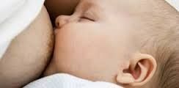
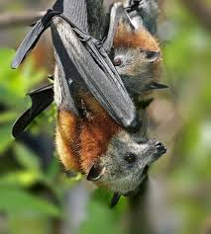
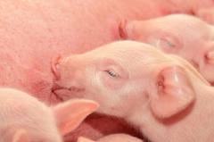
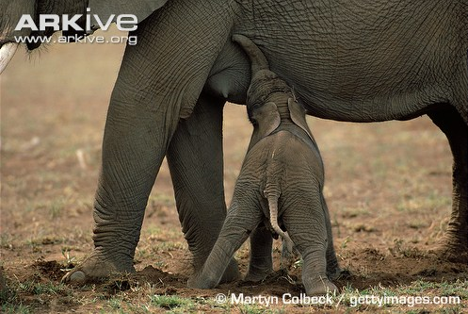
Evolution
The lactation pattern and milk composition in mamals have developed through millions of years
Important for the survival, growth and developement of the offspring of the mammals – including humans

Slide 5
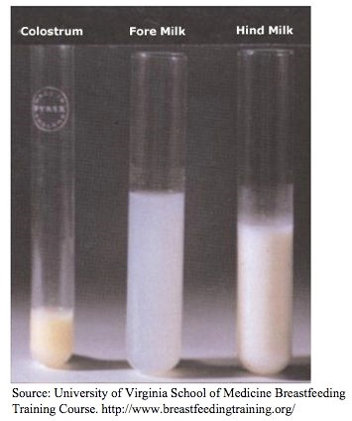
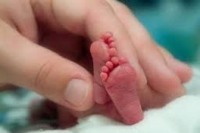
Human milk is dynamic Adjusted to the needs of the spesific child
Gestational age
Term birth-Premature
During the lactational period
Colostrum-mature milk
During the meal
Fore and hindmilk
Human milk is flavoured from the mothers food. The breastfed baby will experience a variation in taste.

Slide 6
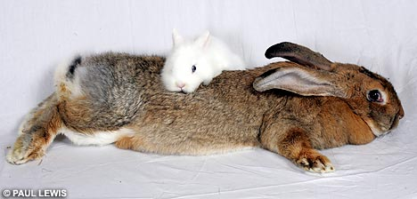
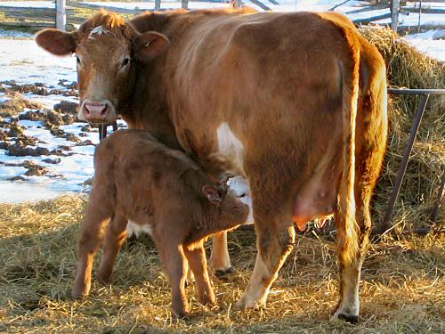
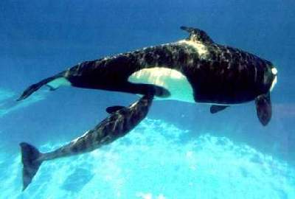
Human milk contains all the nutrients the fullterm baby needs for optimal growth
Except vitamin D in areas of low sunexposure
Whale
Hare
Grams pr. ml.
Cow
Human
Solveig T. Holmsen, Tine Greve, www.ammesenteret.no
Notes:
Alle pattedyr laver ”skreddersydd” melk til sitt avkom
F.eks. er proteinkonsentrasjonen nøye tilpasset artens veksthastighet
Mennesket vokser langsomst og morsmelk har lavt proteininnhold
Fettinnholdet er bl.a. tilpasset måltidshyppighet
Morsmelk har et lavt fettinnhold, og menneskebarn skal spise hyppig
Hareunger og hvalkalve spiser meget sjeldent (1-2 måltider pr. døgn) til gjengjeld er haremelk og hvalmelk meget fettrik
Laktose (melkesukker) innholdet er høyt i morsmelk
Energigiver og viktig for bl.a. utviklingen av barnets hjerne
6

Slide 7
Human milk as medicine immunological and developmental properties
Antibodies –protects against infection
Lactoferrin –antimicrobial and antiinflammatory effect- kills cancer cells, aids in iron absorption. Provides immunoprotection
α-lactalbumin – kills cancer cells after reorganisation to HAMLET Fischer W. Canc Res 2004.
Cytokines – antiinflammatory and immunregulating
Hormones and growthfactors – promotes growth, develompment and correct function of organssytems and metabolism
Lysosym, Oligosaccharides, Glykoproteins

Slide 8
Colostrum is GOLD Transition from intrauterine to extrauterine nutrition
The fetus swallows up to 750 ml amnionic fluid every day in the third trimester. High content of growthfactors.
Colostrum - more like amnionic fluid than mature milk
in composition and bioactivity: Growthfactors function synergistically. Important for growth, maturation and protection of the infants gut and other organs.
Epidermal Growth Factor (EGF) from colostrum > 1000 times the consentration of the mothers serum. EGF receptors in the infants gut and lungs.
68 cytokines in human colostrum. Important for downregulation of inflammation.
Sanglid. Exp Biol Med 2006, Underwood et al. J Perinatol 2005, Jensen et.al Jnutr 2001, Meier et al. Clinics in Perinatology, 2010

Slide 9
Preterm Colostrum
Mammary gland are immature at birth
Preterm colostrum
lasts longer than for term birth
has high level of protection
High consentration of Transforming growth factor – beta
promotes the infants production of antibody Ig A.
Formula should not be substituded for colostrum/human milk unless there are no other alternatives
Oqawa et al. Early Hum Dev. 2004, Meier et al. Clinics in Perinatology 2010
Notes:
(TGF – beta)

Slide 10
Unfortunate effects of formula - since it is not human milk/colostrum
Increasing documentation that
formula might have a harmfull effect
on the maturing of the babies intestine
because of the lack of antiinflammatory effect of human milk/colostrum it increases inflammation
Colostrum/human milk contains numerous factors that downregulates inflammation
Oste et al. J Parenter Nutr 2010, Penn et al. Pediatr Res 2012, Thymann et al. Br J Nutr 2006
Notes:
Morsmelken inneholder mange faktorer som nedregulerer inflammasjon

Slide 11
Disease caused by inflammation
Inflammatory processes affect the developement and maturing of organsystemes
gives an increased risk of tissue damage
Exstreme premature has an increased respons on inflammation and a small compensatory antiinflammatory respons activity
The mothers own colostrum/human milk contains important factors that downregulates the inflammatory respons within the premature barnet
Chaud, Walker. J Clinical astroenterology 2008
Schultz et al. Clin Exp Immunol 2004
Rautava, Walker. Breastfeeding Medicine 2009
Notes:
11

Slide 12
Formula is cowmilk based
Cowmilk - 8 times more protein than human milk
Might lead to too rapid growth the first 6 month
Formula lacks:
important ingredients that you find in human milk regulating metabolism (leptin, insulin-like growth factor, brain-gut peptides, hormoner)
the correct and healthy microbiome
the correct fatty acide composition
Formula activates inflammation
The baby might have little influence on the pace and amount to eat when bottelfed
Bartok et al. Int J Pediatr Obesity 2009, Li et al. Pediatrics 2008

Slide 13
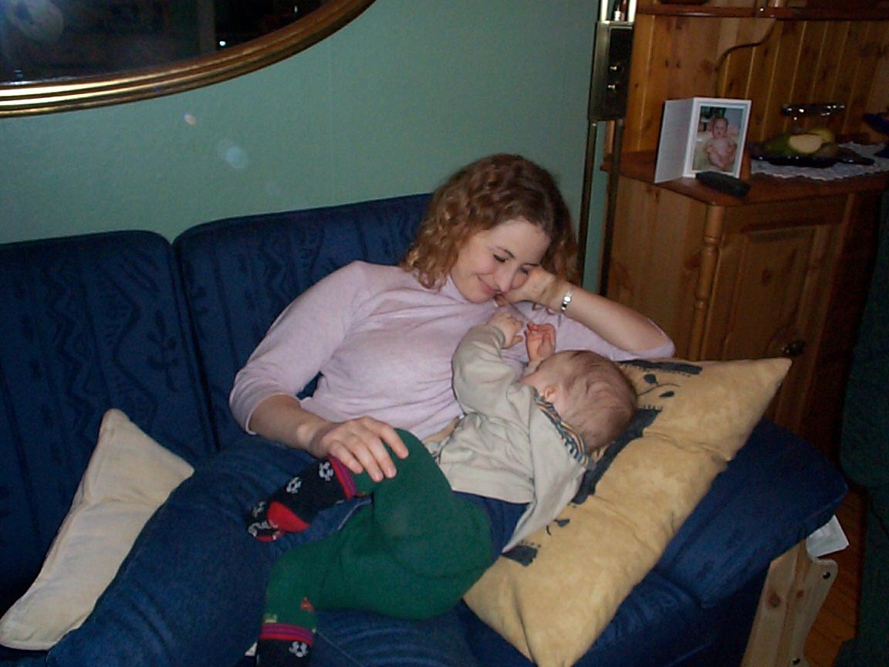
Breastfeeding benefits increases with the duration of breastfeeding
Human milk – is tailored nutrition for the baby
WHO recommandation:
Exclusive breastfeeding until 6 months
Continued breastfeeding until at least 2 years

Slide 14
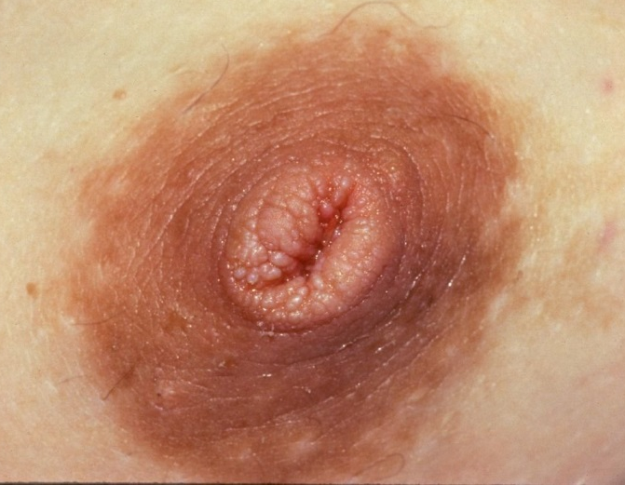
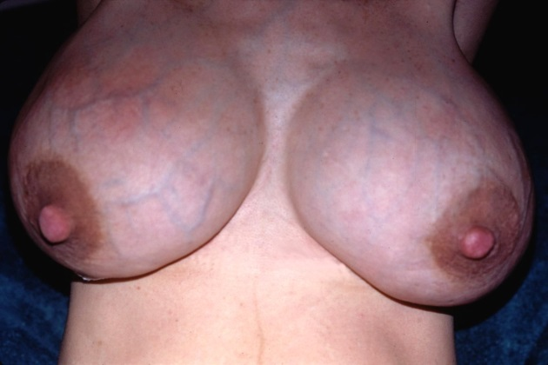
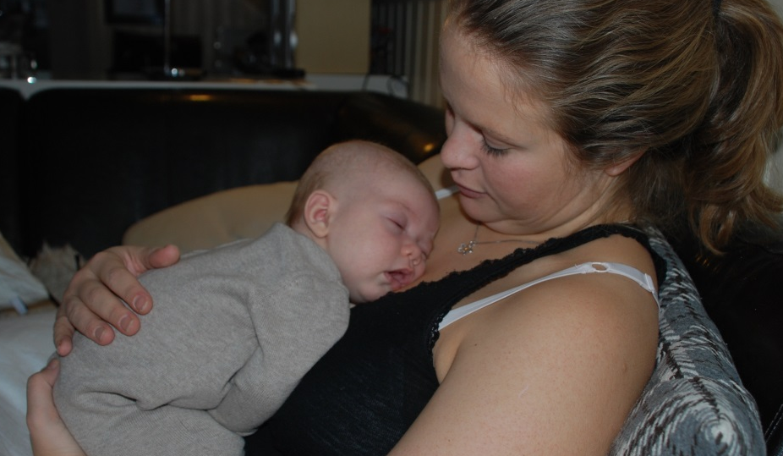
Breastfeeding counselling and difficult cases
Inverted nipples – Engorgement - Sleeping babies

Slide 15
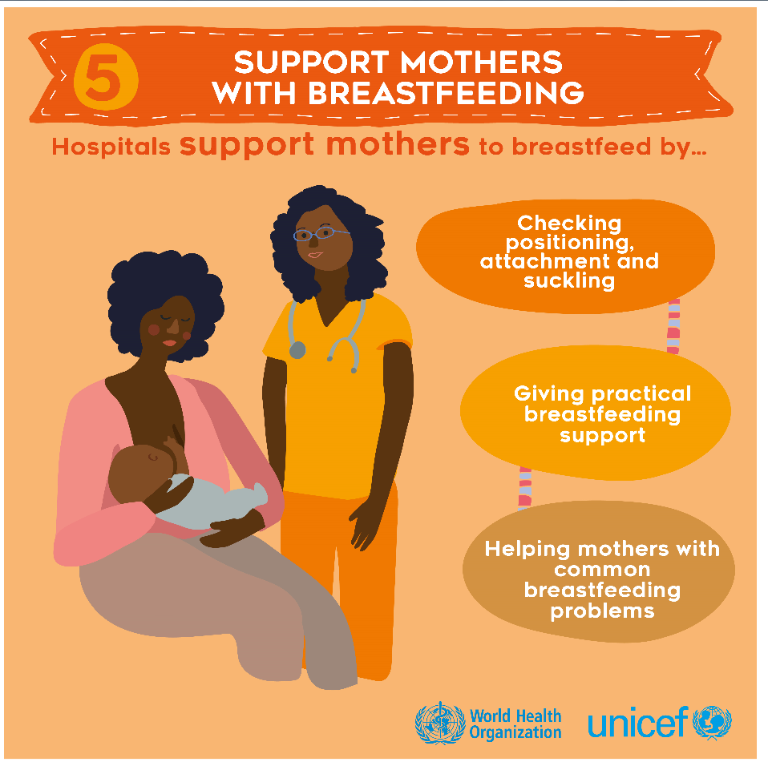
WHO
Recommendation

Slide 16
A systematic aproach
What is the problem?
How to assess it?
How to counsell?
Notes:
Først dialog og observasjon – så veiledning

Slide 17
A systematic aproach
Breastfeeding positions
Assessment of mother and breast
Positioning of the baby
Attatching the baby to the breast
Assessment of latch
Notes:
Først dialog og observasjon – så veiledning

Slide 18
1. What position do they use when breastfeeding? Is it the best for this spesific chanlenge? How does the mother hold the baby?
2. How does the mother feel? What is she saying about the problems? What does the breast lool like? Is it large,droopy,floating, small, tight, hard, full or loose? Is it possible to support or form the breast?
3. How does the mother handle the baby when attaching to the breast? Is it optimal when considering the attachment?
4. How involved in the attacment of the breast is the baby? Does the mother wait for baby’s signals of readyness to attach? Does the baby open her mouth wide?
5. When the baby is attached, what does it do? How does the mother feel? What does it look like?

Slide 19
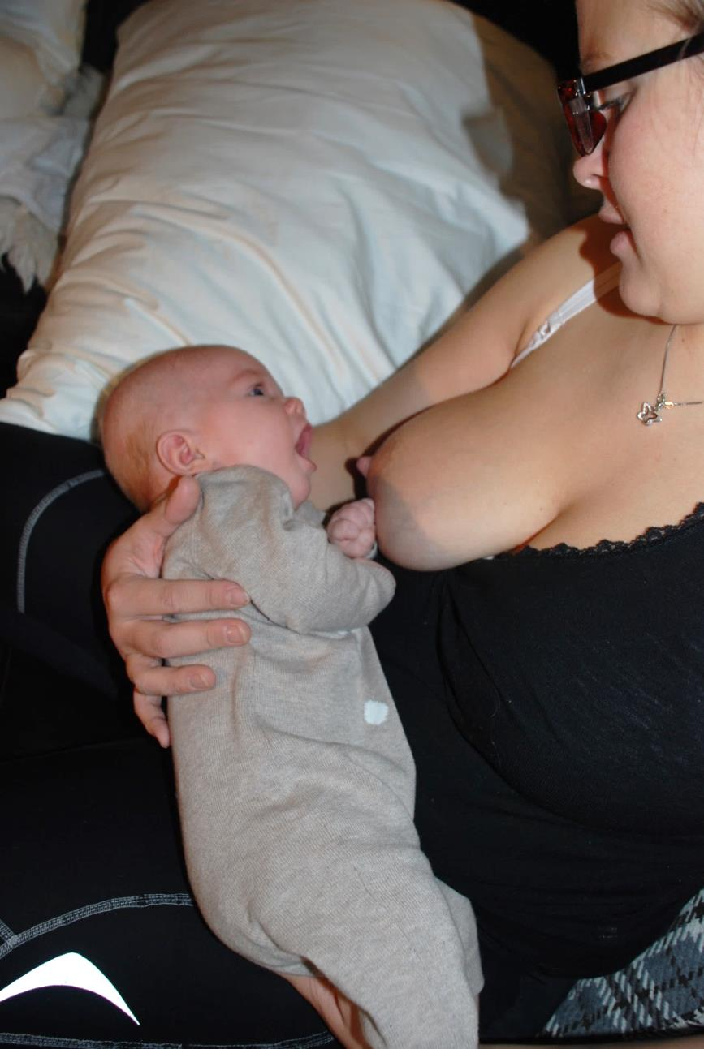
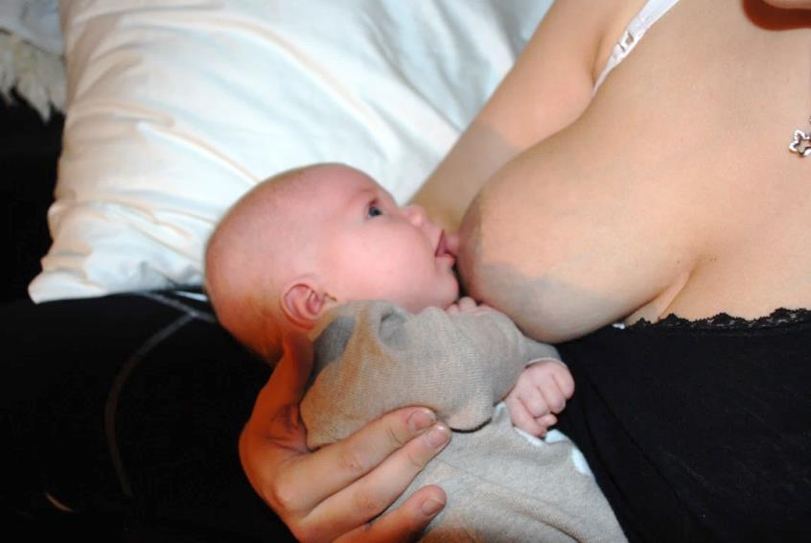
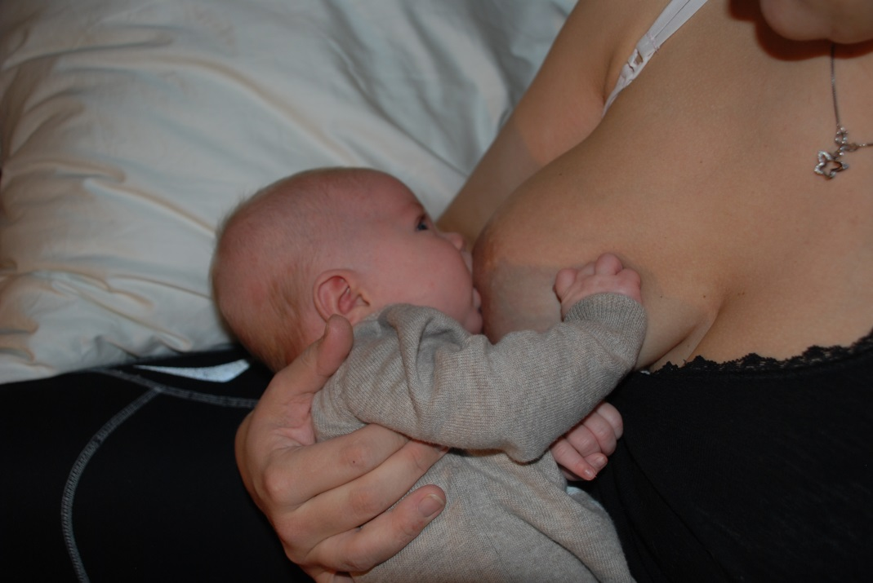
Cradle hold

Slide 20
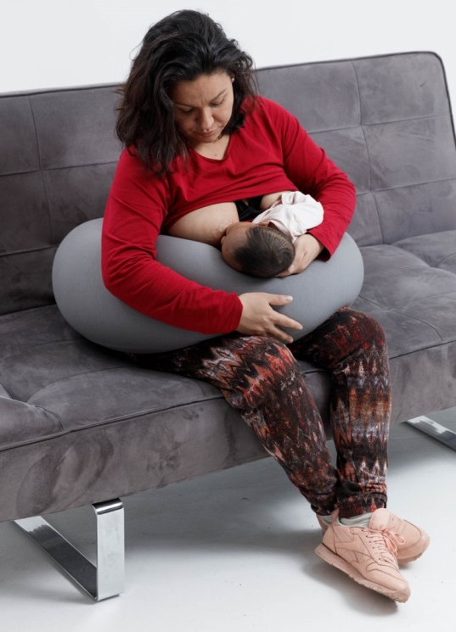
Cross-cradle hold
Notes:
Betyr egentlig ikke hodet i hånden!
Kan gi en opplevelse av kontroll
Lettere å fysisk støtte
Gap og koblingsøyeblikk

Slide 21
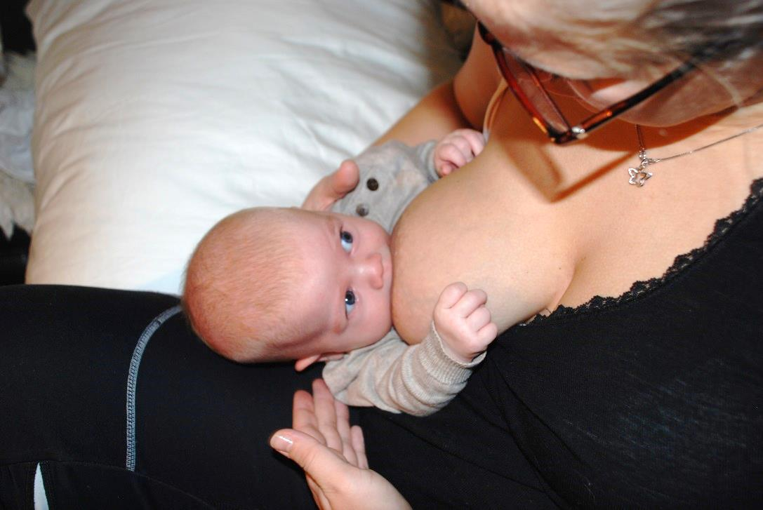
Twin position
Notes:
I høyde med brystet?
Nese mot brystknopp?
Tett inntil mors kropp
Rett linje i kroppen – vendt mot mor

Slide 22
Laying on your side
Notes:
I høyde med brystet
Tett inntil mors kropp
Rett linje i kroppen – vendt mot mor
Nese mot brystknopp

Slide 23
Biological nurturing (Laid-back position)
Promotes primitive neonatal reflexes which act
as breastfeeding stimulants
Notes:
Barnets reflekser stimuleres = forbundet med bedre ammekompetanse
Mamma kan godt hjelpe til!
Plassere barnet nær brystet
Helst litt i underkant
Støtte og holde barnet men det leter seg frem
Forme brystet som hjelp
(obs. etter barnets munn)
Støtte barnet så det slapper av mens det dier
Sørge for god og avslappet stilling
Puter i ryggen og støtte under armene
Barnet får bruke sine egne reflekser
Blir en mer aktiv deltaker

Slide 25
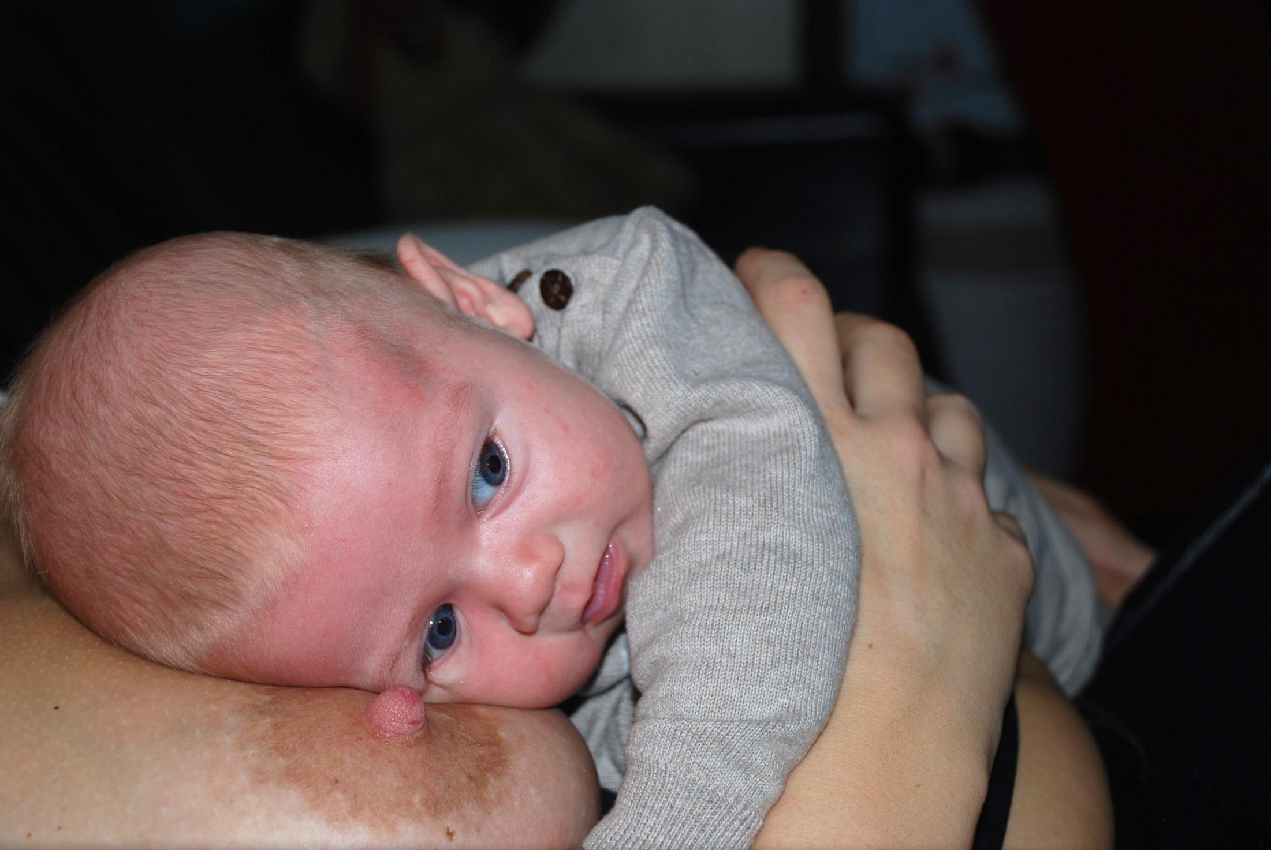

Slide 26
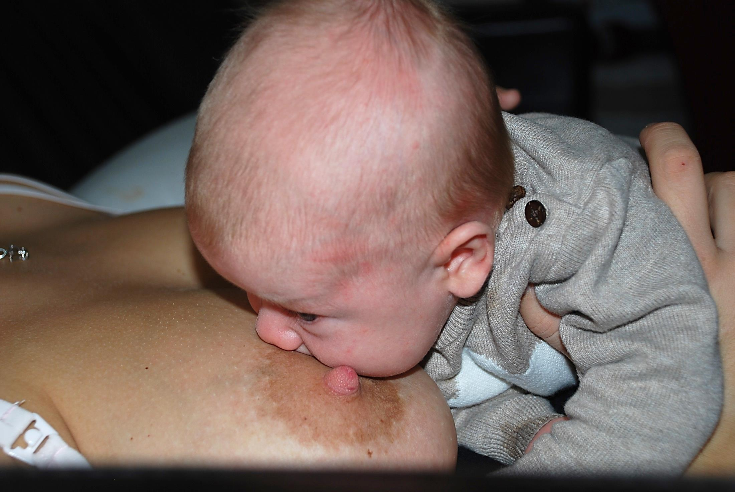

Slide 27
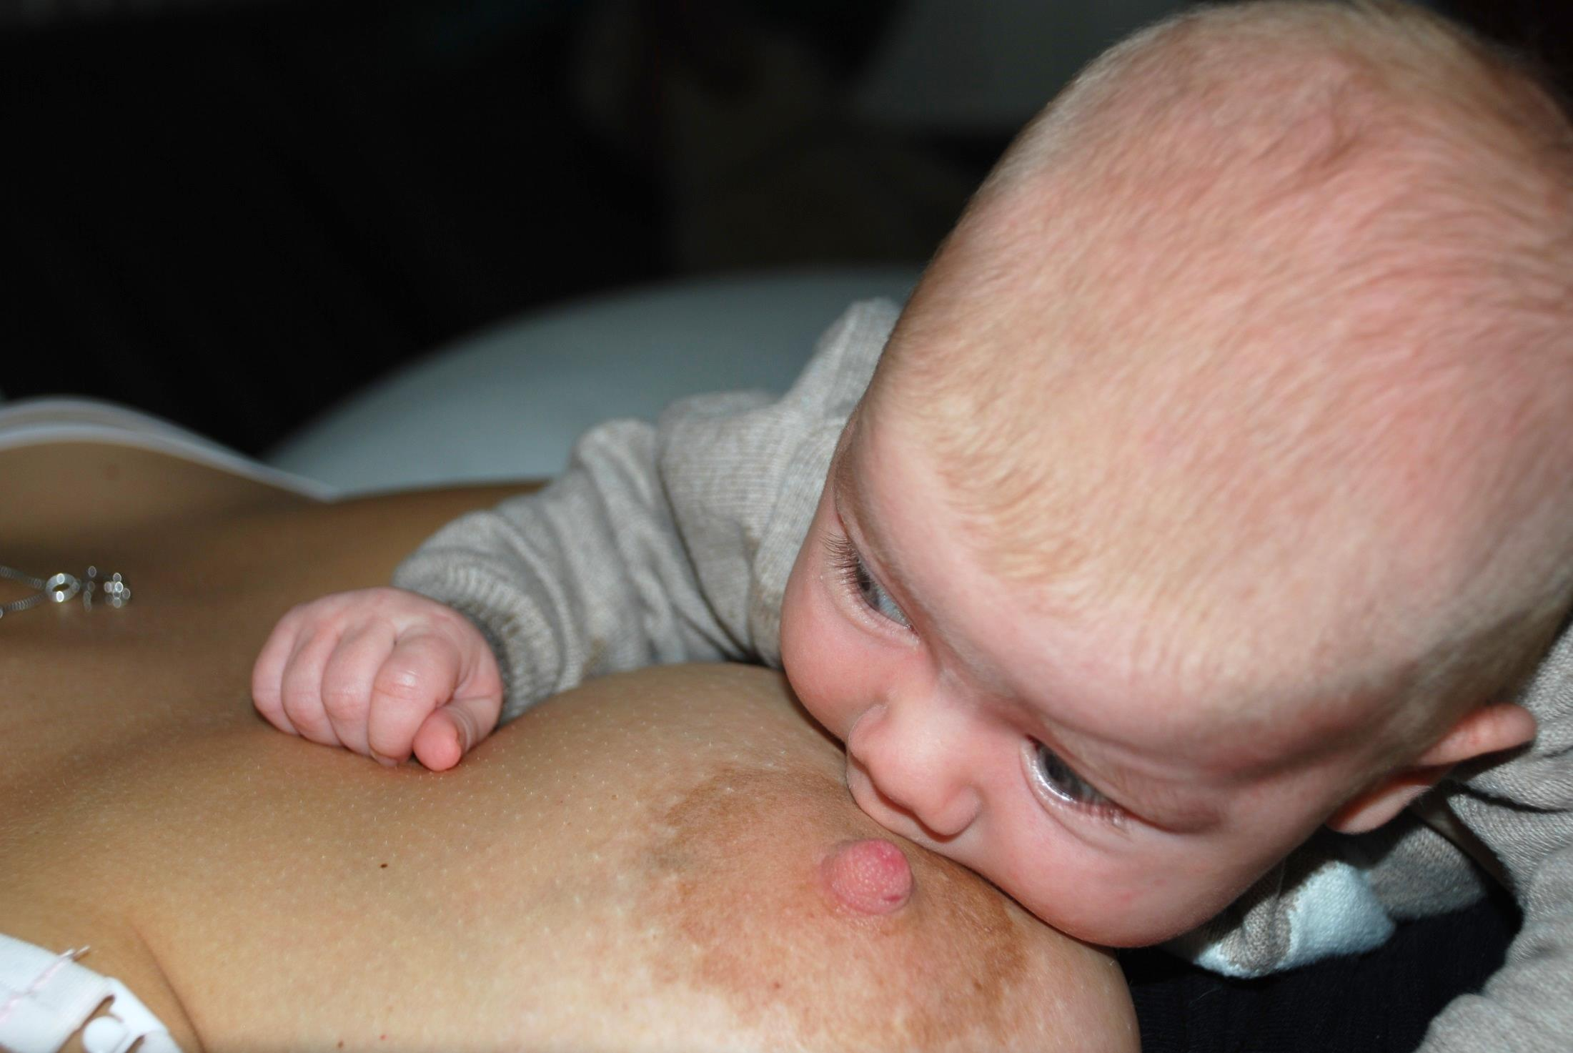

Slide 28
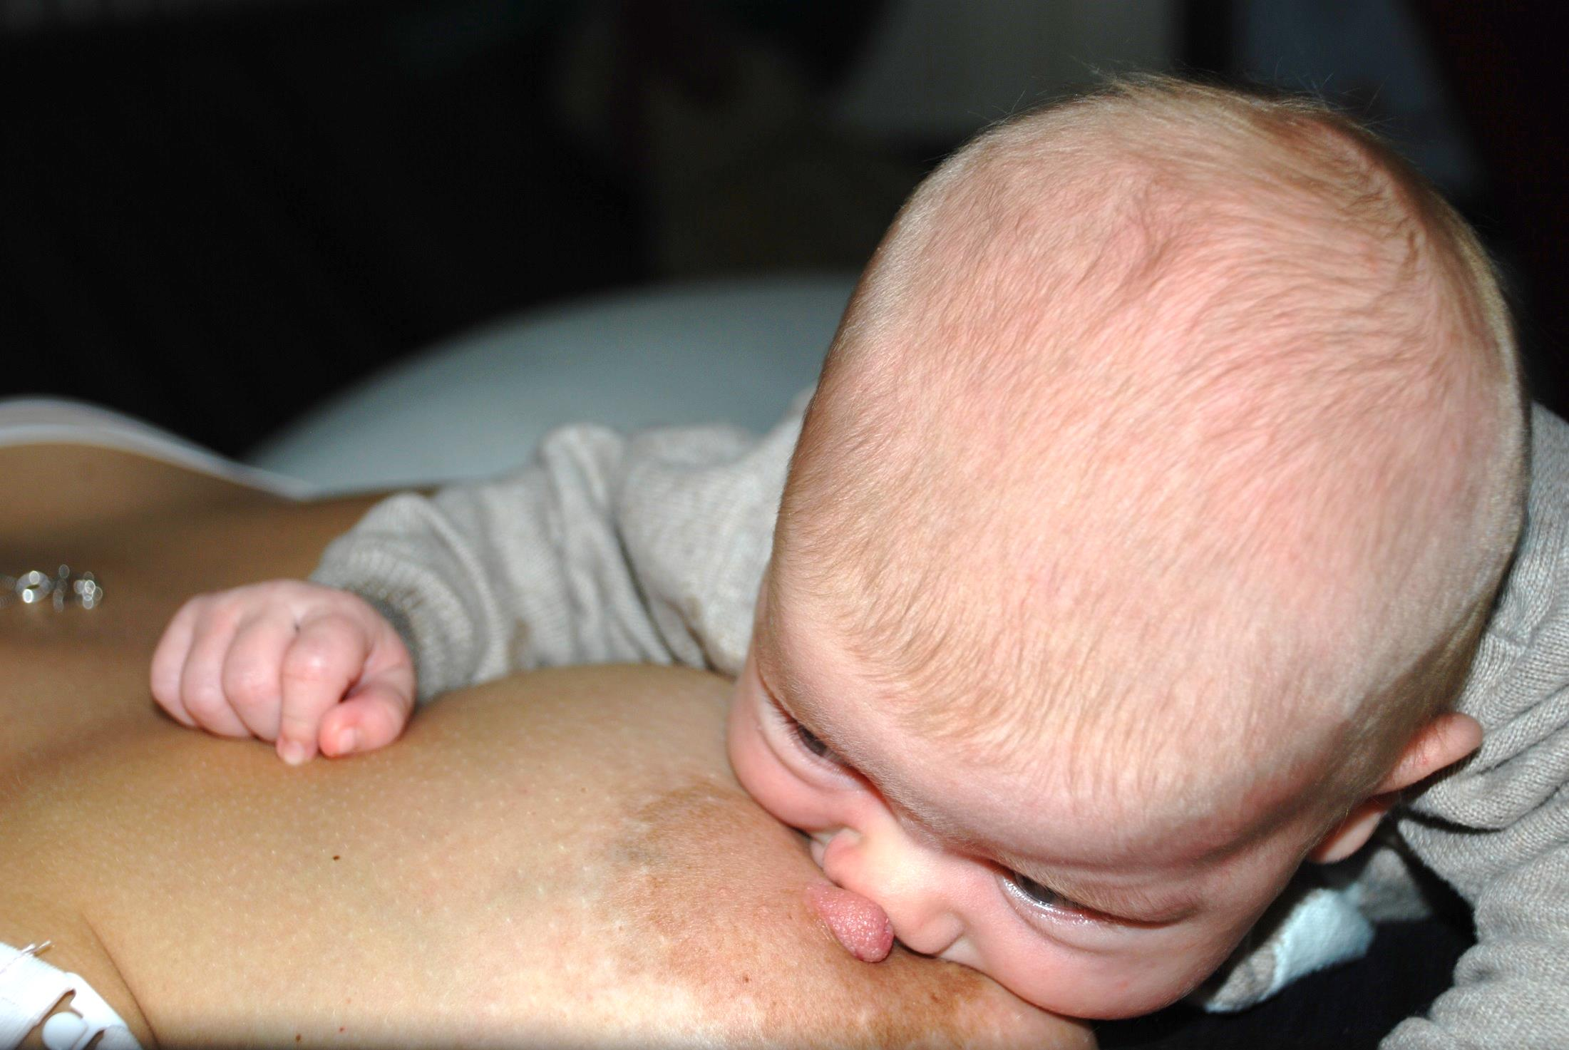

Slide 29
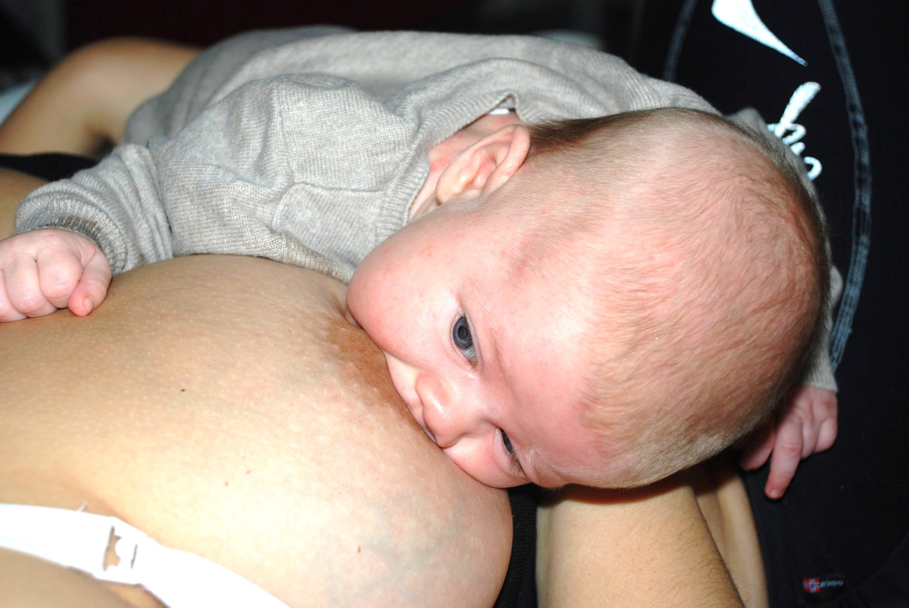

Slide 30
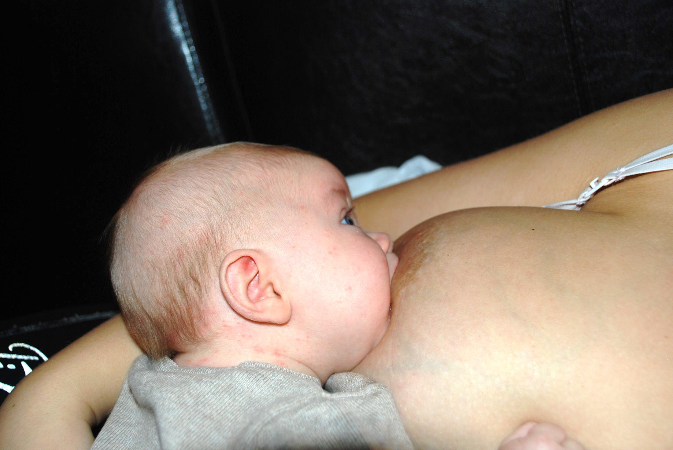

Slide 32
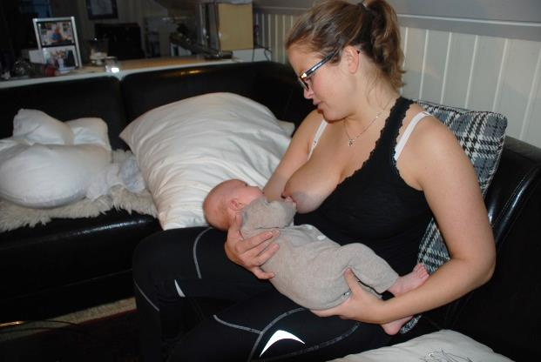
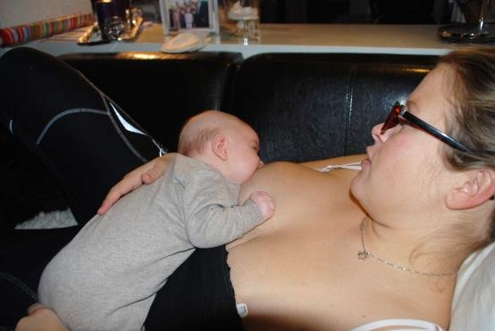
Breastfeeding observation
Mother and breast
Mothers body - position and posture
Pain/discomfort?
The breasts

Slide 33
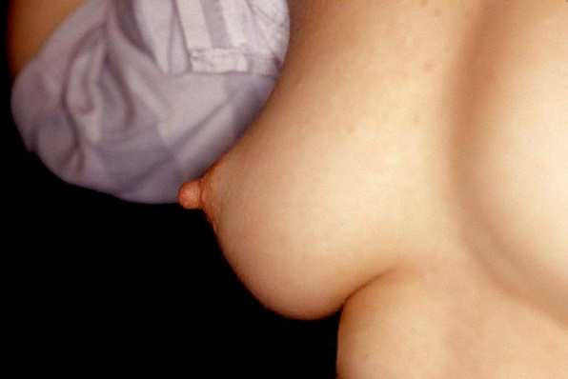
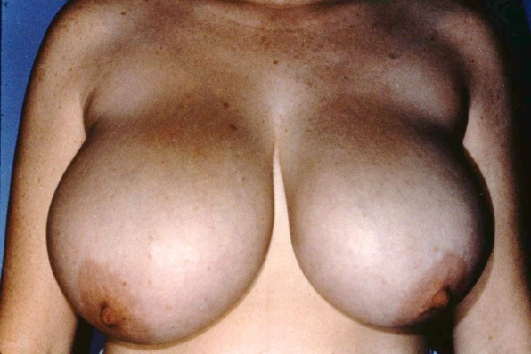
The breasts
Shape and size<+
Engorgement?
Soft or hard breasts?
Can the mother shape the breast?
The nipple:
Shape, size, flattened or defined?
Notes:
These pictures are from the book: Breastfeeding atlas (except the one in the middle on the right sight)

Slide 34
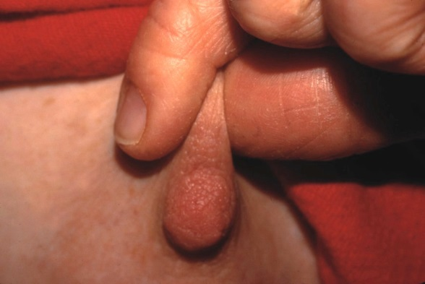
Shaping the breast:
What direction?
The baby’s mouth controlles the direction
Notes:
The two pictures to the right are from the book: Breastfeeding atlas

Slide 35
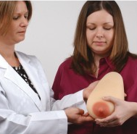
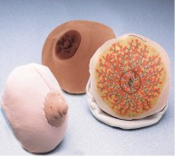
NB! Not to close to the nipple!
Important to communicate in a friendly way with the mother
Notes:
Dersom forming er vanskelig, hva da?
Holder mor for tett på areola?
Hvor er pekefingeren
Er brystet lite og stramt – stort og tungt?

Slide 36
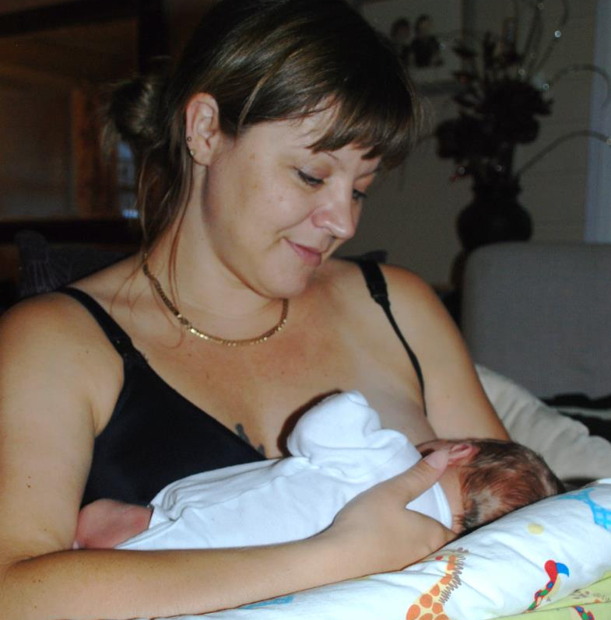
Positioning of the baby
Keep the baby close to mothers body
Straight line ear– shoulder - hip
In the same hight as the breasts
Starting point before latch: Nose towards nipple
Notes:
The picture at the botten is from the book: Breastfeeding atlas

Slide 37
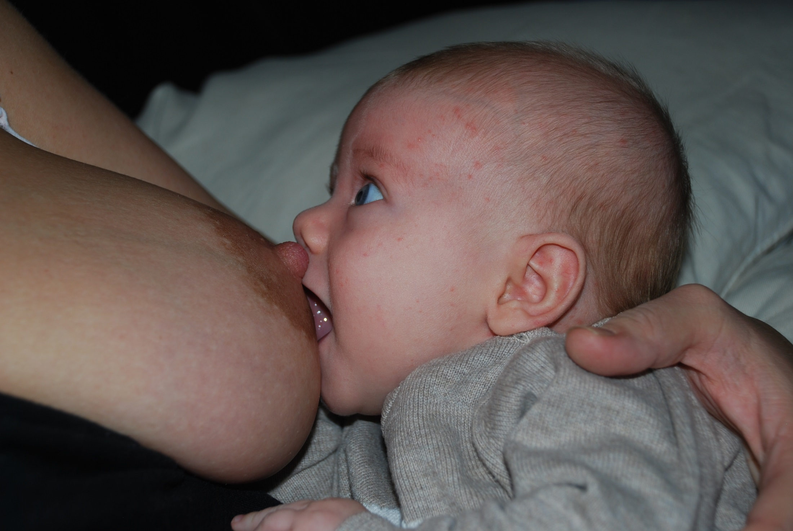

Slide 38
Notes:
These pictures is from the book: Breastfeeding atlas

Slide 39
Wide open mouth is very important
Secures:
-that the nipple hit far back in the soft palate
much breast in the baby’s mouth
that the tounge places itself correctly around the teat
Notes:
The tounge comes out on to the lower lip when attaching to the breast
The tounge curls around the breast/teat

Slide 40
The gaping reflex is triggered
-when the breast/nipple touches the baby’s upper lip and nose

Slide 42
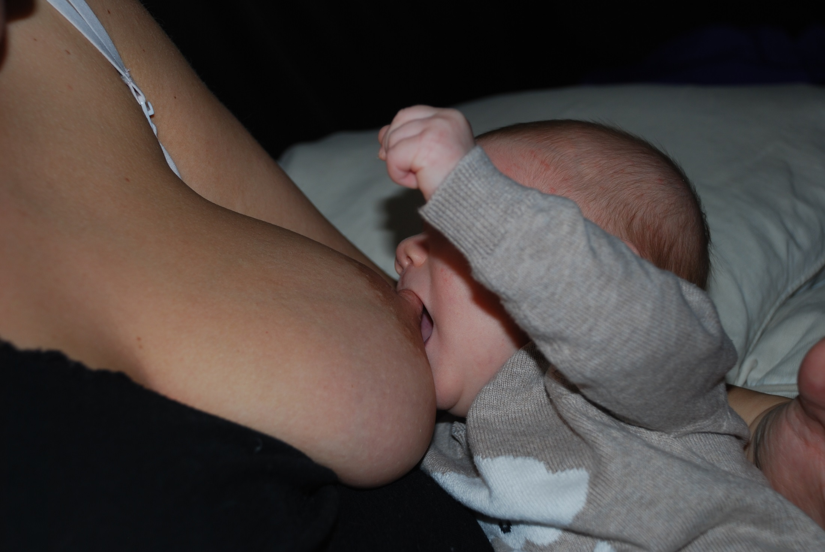

Slide 43
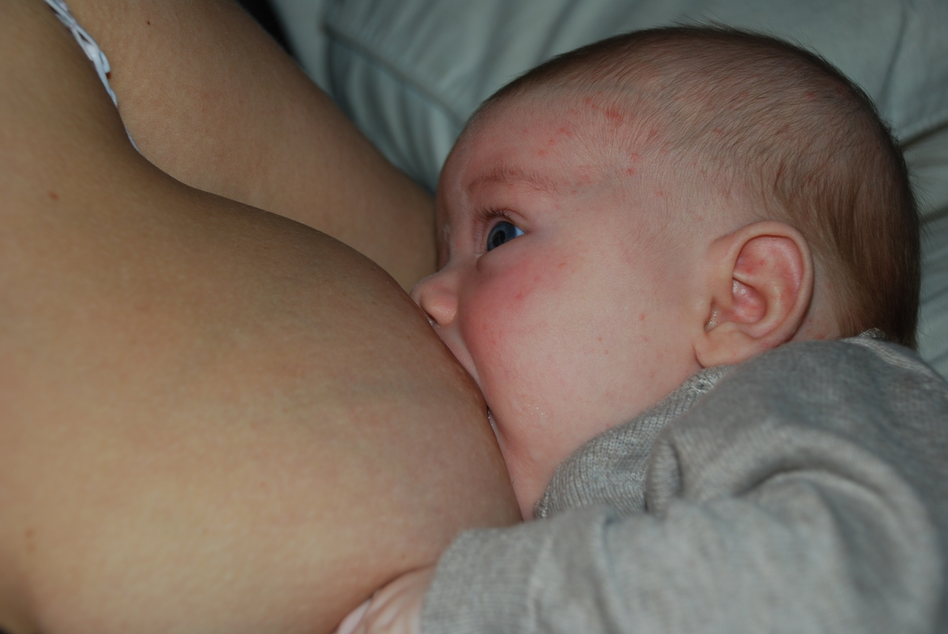

Slide 44
Two key points when assessing the latch:
No pain for the mother
Milk transfer to the baby
Notes:
Evt hvordan ser egentlig bk ut?

Slide 45
Assessment of latch
What to look for:
Much breast in baby’s mouth
Assymetrical latch
Chin and cheek close to breast and nose free to breathe
Neck slightly extended, chin is not flexed toward baby’s chest
Baby is actively suckling and swallowing milk
Nipple round when baby if finnished (Not pinched and white)

Slide 47
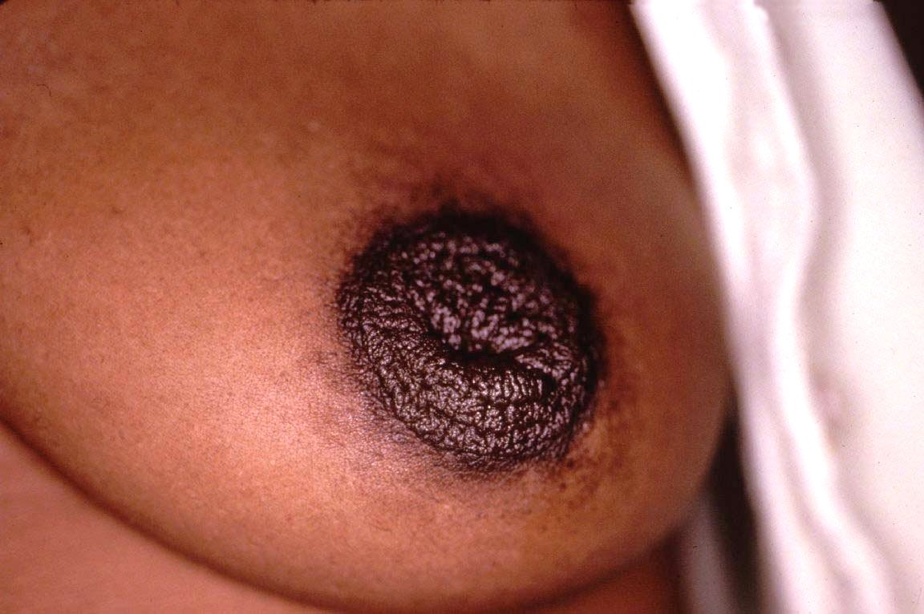
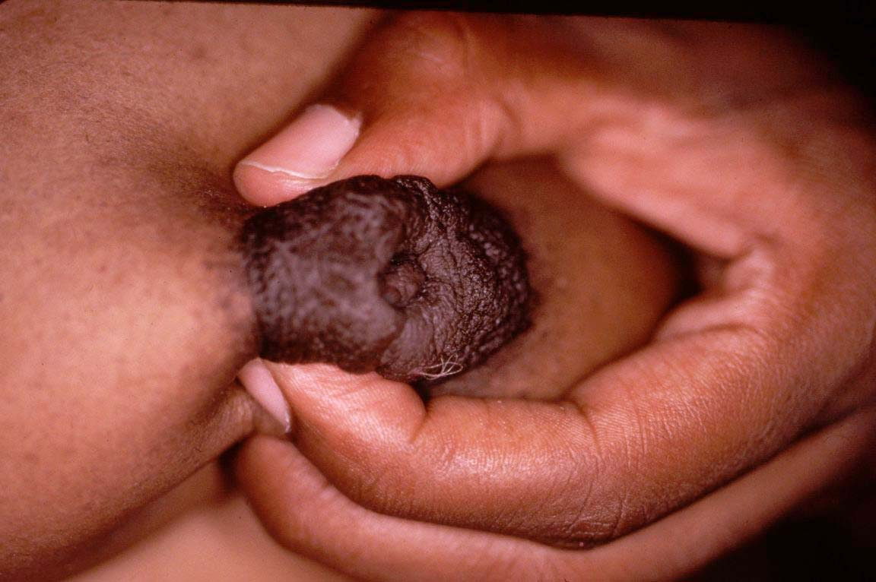
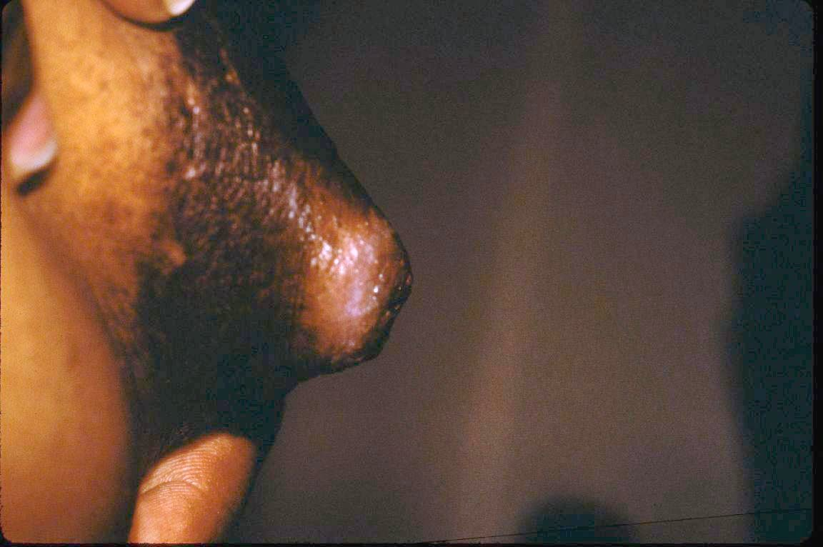
Inverted nipples
Are these true inverted nipples or not?
Notes:
Igjen – det heter å ta bryst – ikke brystknopp!

Slide 48
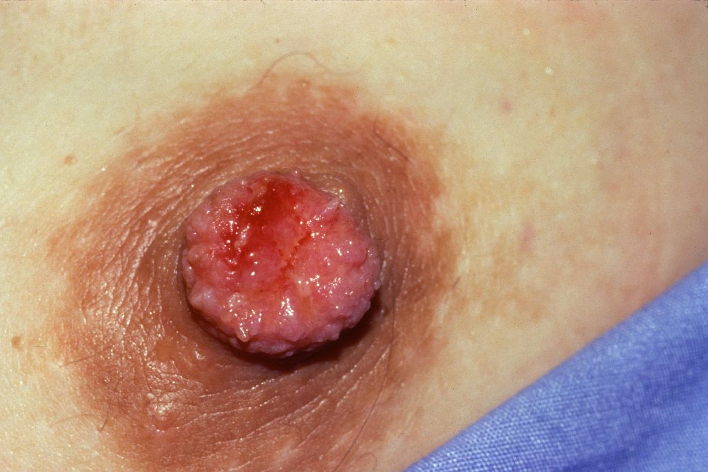
Inverted nipples
If not true invertion
Key point
The baby is not supposed to take the nipple but the breast
Notes:
If not true invertion

Slide 49
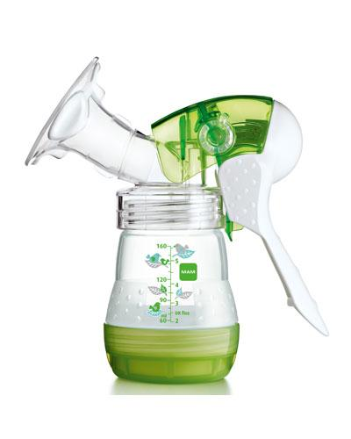
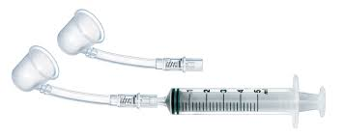
Niplette or pump might help
x
Notes:
x

Slide 50
Engorgement
Physiological engorgement
Milk indused engorgement
Potential consequenses?
Notes:
Økt trykk i brystet som blir stående over lengre tid → atrofi av celleveggen på alveolene → redusert produksjon
Potensielle konsekvenser?

Slide 51
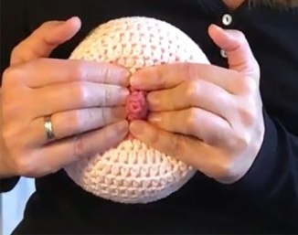
Ensure that the baby is well attached (systematic approach)
If problems with attachment:
Cottemann
If physiological engorgement: Frequent breastfeeding
If milk indused engorgement: What is the reason?

Slide 52
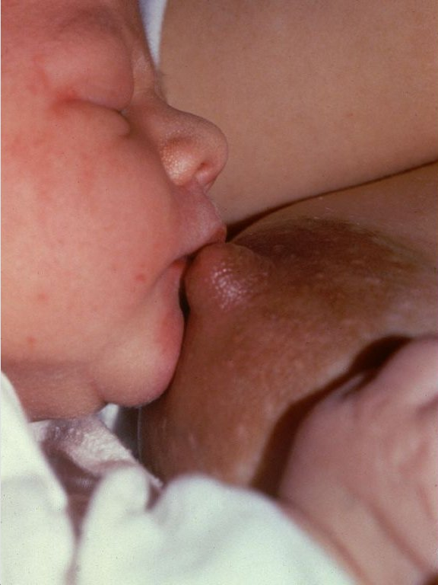
Sleepy baby
What is the reason for the sleepiness?
Poor attachment? Falling asleep quiqly after starting breastfeeding?
Jaundice?
Exessive weightloss?
Mother has little or no milk?
Counselling:
Baby needs to eat
Hand expression or puming
Cup feeding
Stimulate the baby to wake up
SKIN TO SKIN CARE – will also stimulate to better attachment

Slide 53
Cup feeding instead of bottle feeding
WHO Recommendation
If expressed breast milk or other feeds are medically indicated for preterm infants, feeding methods such as cups or spoons are preferable to feeding bottles and teats (recommended, moderate-quality evidence)
World Health Organization. (2017). Guideline: protecting, promoting and supporting breastfeeding in facilities providing maternity and newborn services s.20).
Notes:
What is best, cup/spoon feeding or bottlefeeding?
Are there any risks of bottlefeeding?
Are there any risks of cup/spoon feeding
What are the infants’ cues for feeding?
What are the infants’ cues when full/finnished eating?
What is proper respond to infants’ cues?
Do you know how to cup feed?
How did you learn to cup feed?
Have you taugh anyone else to cup feed proper?
How to support breastfeeding when the baby is in the Nicu?
If mother is present?
If mother is in her home?
Can you give a pasifier to the neonate?

Slide 55
BFHI 2017
Feeding preterm infants who were unable to breastfeed by cup rather than bottle probably
improved exclusive breastfeeding at discharge,
may improve any breastfeeding at discharge,
probably improves any breastfeeding at 3 months
probably improves any breastfeeding at 6 months
World Health Organization. (2017). Guideline: protecting, promoting and supporting breastfeeding in facilities providing maternity and newborn services s.20).

Slide 56
WHO Recommendation on feeding practices and additional needs of infants
Mothers should be supported to recognize their infants’ cues for feeding, closeness and comfort, and enabled to respond accordingly to these cues with a variety of options, during their stay at the facility providing maternity and newborn services (recommended, high-quality evidence).
World Health Organization. (2017). Guideline: protecting, promoting and supporting breastfeeding in facilities providing maternity and newborn services s.20).

Slide 58
Responsiveness to the prematures babies cues also aplies to health personell
Premature babies cues for feeding
Premature babies cues when not able
Awake (eyes open, looking around)
Alert
Moving mouth and toung
Postural
control
tone
Movement patterns
Cardiorespiratory stabile
Active laping/licking when offereded the cup
Change in state of alertness
Sleepy/sleeping
Change in
postural control/tone/patterns
Change in cardiorespiratory behavior
Coughing, Chocing, Turning blue
Signaling for stop feeding
Strech out hands
Not laping/licking milk
Turn head away
Close eyes
Notes:
Premature babies cues for feeding

Slide 59
Support of breastfeeding for mothers with premature babies
WHO Recommendation
Mothers of infants admitted to the neonatal intensive care unit should be sensitively supported to enable them to have skin-to-skin contact with their infants, recognize their infants’ behaviour cues, and effectively express breast milk soon after birth.
World Health Organization. (2017). Guideline: protecting, promoting and supporting breastfeeding in facilities providing maternity and newborn services (p.xi).
Notes:
Mothers of infants admitted to the neonatal intensive care unit should be sensitively supported to enable
them to have skin-to-skin contact with their infants, recognize their infants’ behaviour cues, and effectively
express breast milk soon after birth. (pxi)

Slide 62
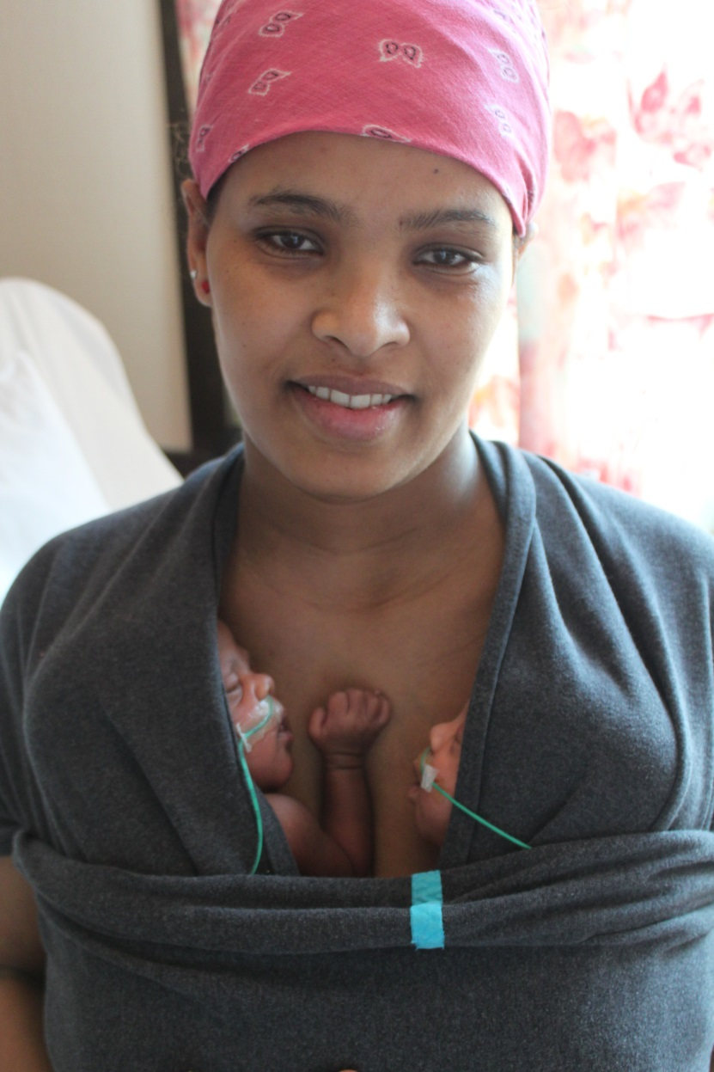
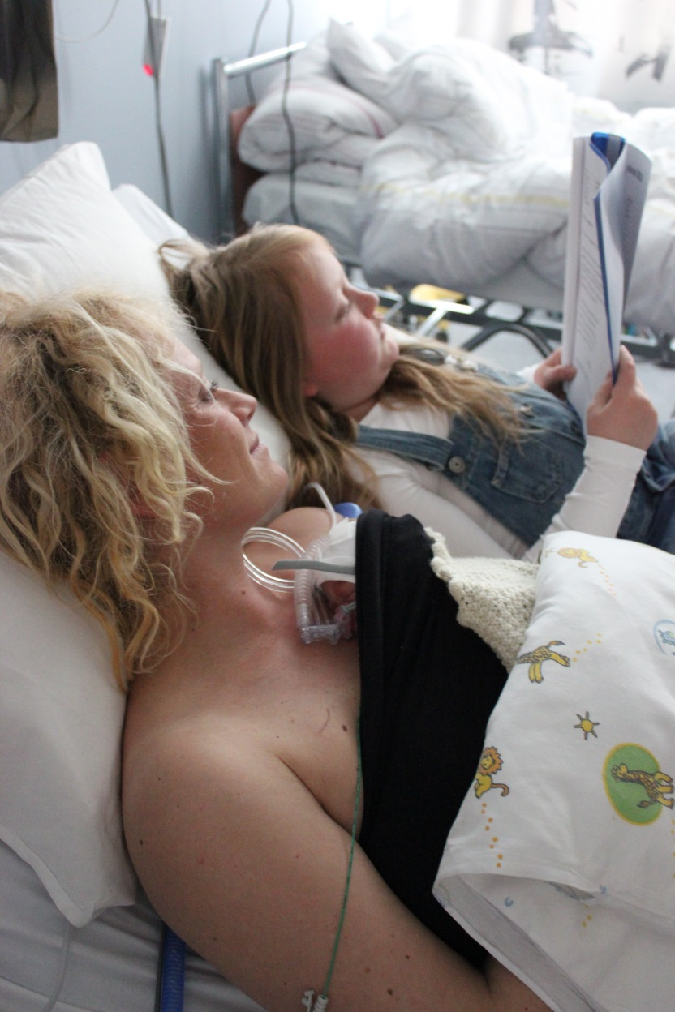
Skin-to-skin for premature babies

Slide 63
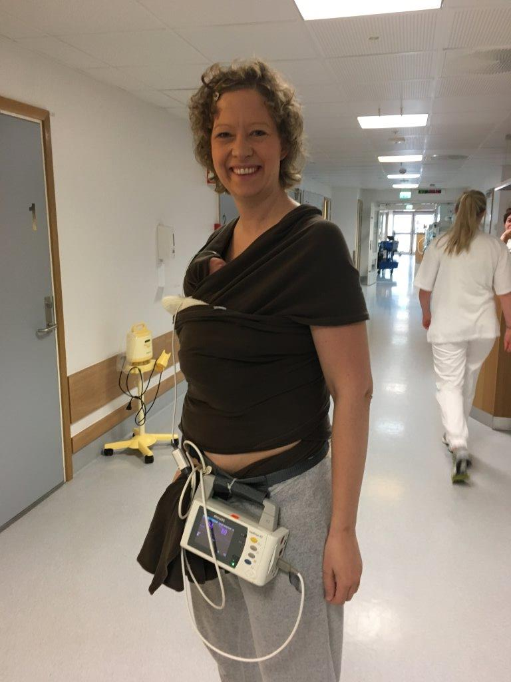

Slide 65
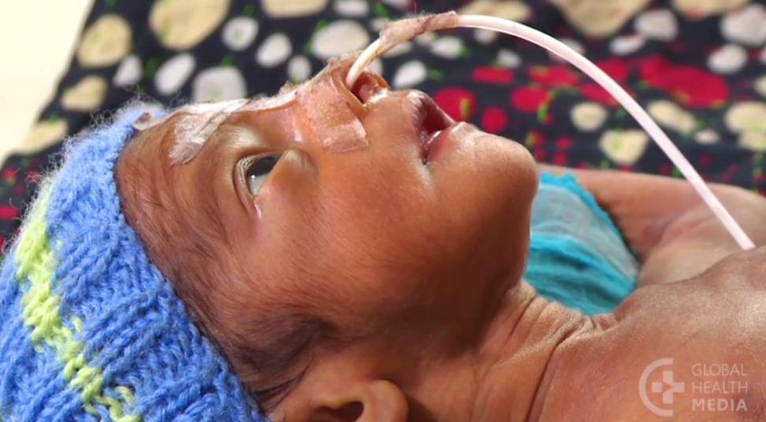
Responsiveness to the babies cues for readyness for feeding:
Awake (eyes open, looking around)
Alert
Moving mouth and toung
Postural
control
tone
Movement patterns
Cardiorespiratory stabile
Active laping/licking when offereded the cup

Slide 66
Responsiveness to the premature baby’s cues when hungry, full or not able to eat more due to maturety
Change in
state of alertness
postural control/tone/patterns
cardiorespiratory behavior
Coughing, Chocing, Turning blue
Signaling for stop feeding
No laping/licking milk
Strech out hands
Turn head away
Close eyes
Sleepy/sleeping

Slide 67
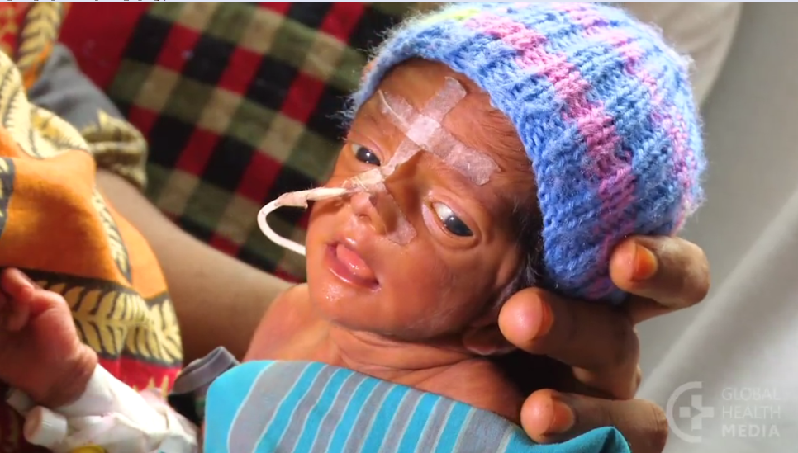
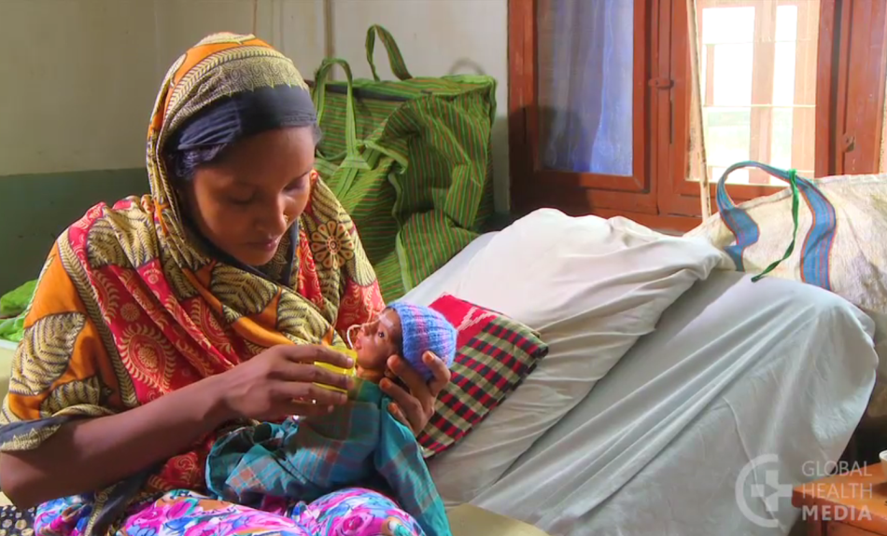
Proper cup-feeding
Wash hands
Make ready the milk
Wrap the baby
Hold baby in nearly up-right position on you lap
Support baby’s hand and neck

Slide 68
Proper cup-feeding
Rest the cup lightly on baby’s lower lip
Tip the cup UNTIL the milk reach the top-edge
Let the baby take the milk (laping/licking)
Let the baby deside the pace
pausing when baby needs it
Leave the cup resting on lover lip and milk level with rim
Do NOT tilt and pour inn milk
Notes:
pace

Slide 69
Proper cup-feeding
Cues that the baby had enough
Strech out hands
Closes mouth
Turns his head away
Fall asleep

Slide 70
Proper cup-feeding
Safety tips
Never pour milk into the baby’s mouth!
Never feed a sleeping baby
Never feed when baby is lying down
Can cause choking !

Slide 71
Responsive feeding
Register baby’s intake over 24 hours
If baby has not taken the amount he needs:
Either
Feed the baby more often
or
Give the rest by tube-feeding

Slide 72
How to cup-feed proper
Global health media: Film
Cup-feeding your small baby
Notes:
Cup-feeding your small baby

Slide 73
Recommendations on feeding practices and additional needs of infants
9. For preterm infants who are unable to breastfeed directly, non-nutritive sucking and oral stimulation may be beneficial until breastfeeding is established (recommended, low-quality evidence).
World Health Organization. (2017). Guideline: protecting, promoting and supporting breastfeeding in facilities providing maternity and newborn services s.20).

