Slide 1
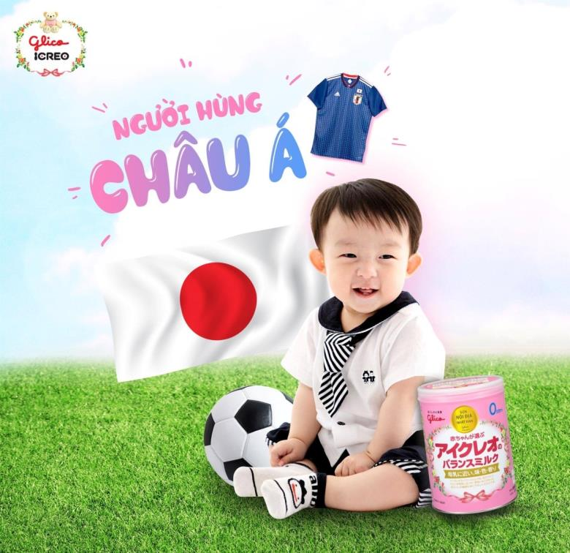


Inappropriate promotion of Japanese formula products in some Southeast Asia countries
Notes:
Facebook Me Nhat Nuoi Con managed by SnB Company (Viet Nam) – authorized distributor of Ezaki Glico Group (Japan)
Source: https://www.facebook.com/GlicoMeNhatNuoiCon/photos/a.481148048725356.1073741827.481147155392112/996121843894638/?type=3&theater
It says the win by the Football Team of Japan over Senegal in the World Cup 2018 was thanks to the players’ strong health that Glico Icreo has been contributing to. Japan team is “Asian Hero”. Product (Step 0) appears in the photo is for baby from 0-9 months. Subject to Viet Nam Government Decree 100 (2014), advertisement and promotion of formula products for children under 2 years old is prohibited.

Slide 2
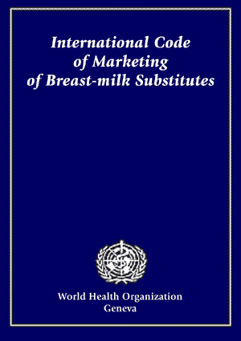
International Code of Marketing of Breastmilk Substitutes improves breastfeeding practices
Optimal breastfeeding practice could save the lives of more than 800,000 children and 20,000 women annually
Adopted and enforced at national level to hold companies responsible
Mothers have the right to unbiased information on how to feed their children
Notes:
Despite a large amount of evidence, breastfeeding practices remains suboptimal globally. Marketing of breastmilk substitutes has a negative impact on optimal breastfeeding behaviors by altering knowledge, intention, beliefs, self-efficacy, and social norms of mothers and other caregivers.
Optimal breastfeeding practice could save the lives of more than 800,000 children and 20,000 women annually. In 7 countries of Southeast Asia alone, more than 12,000 deaths could be prevented.
The International Code of Marketing of Breastmilk Substitutes has guided the promotion and protection of breastfeeding over the last 35 years by setting provisions as a minimum standard to be adopted by nations. The voluntary Code calls on individual governments for legislation and enforcement.
This study reviewed regulations and performed a media audit of promotion of products under the scope of the International Code of Marketing of Breastmilk Substitutes in Southeast Asia.

Slide 3
(in 2017)
Notes:
To conduct this study, we began by collecting legal documents to understand each country’s specific regulations around the Code. For each policy, we qualitatively extracted information about the type of legal document, the products, age range, and type of promotion under the scope of the regulation.
Between Jan 2015 and Jan 2016, independent media agencies were contracted to perform systematic media monitoring in each country. The media scan lasted for 3 months in Viet Nam and 6 months in Cambodia, Indonesia, Myanmar, and Thailand. Systematic methods were followed to sort and analyze all materials identified as part of the scan.

Slide 4
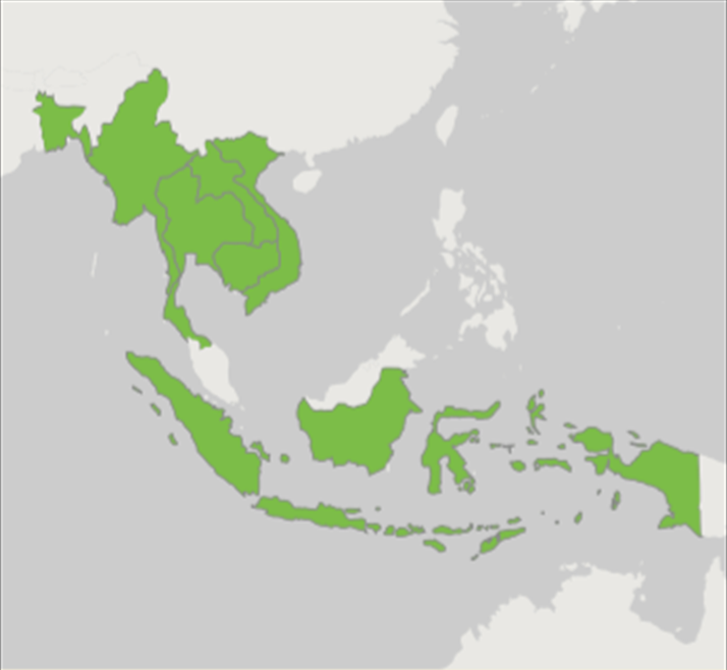
Breastmilk substitutes industry is growing nearly 10% per year. Southeast Asia is a key market.
Poor implementation of BMS Codes
BMS industry increasing their marketing budgets
Low breastfeeding rates
Notes:
Rapid economic growth and a large child population make Southeast Asia an important market for baby foods, including breastmilk substitutes. Breastfeeding practices remain suboptimal in Southeast Asia: early initiation of breastfeeding rates are less than 50% and exclusive breastfeeding rates are only 30%. There are large variations in breastfeeding practices in the region. For example, the exclusive breastfeeding prevalence was 74% in Cambodia (in 2010), 24% in Vietnam (in 2014), and 12% in Thailand (in 2012).
Global sales of BMS were $US 44 billion in 2014 and have grown by nearly 10% each year. To expand market size, BMS companies aggressively market their products in this region and growing-up milk is the key product line, accounting for 50% of market growth between 2013 and 2018. Marketing of GUM contravenes the Code because it usually confuses mothers and family members about child age (i.e. a 12-month-old child in the advertisements could be perceived as a younger infant) and add-in nutrients or non-nutrients (i.e. closer to breastmilk, but sounds like better than breastmilk).

Slide 5
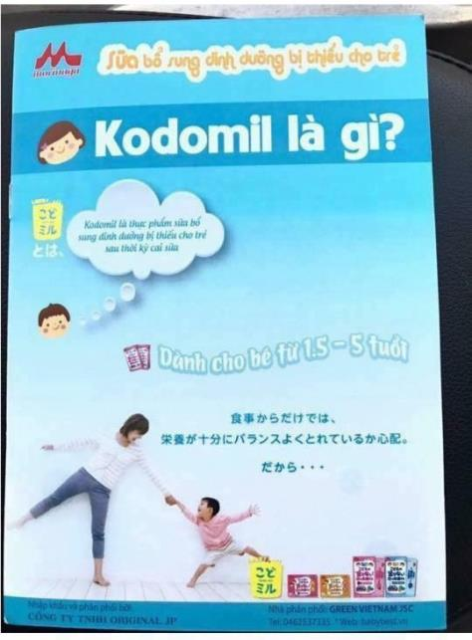
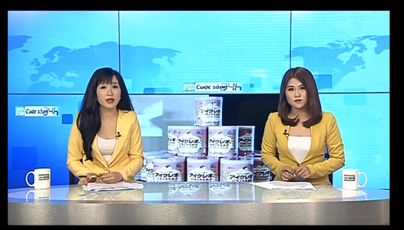
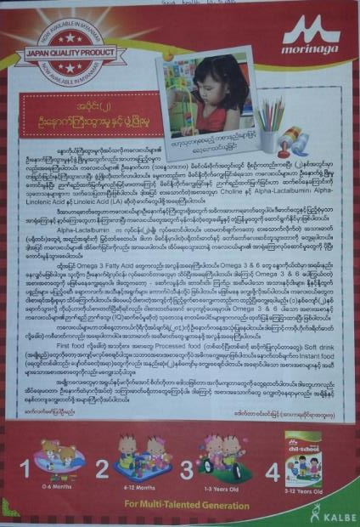
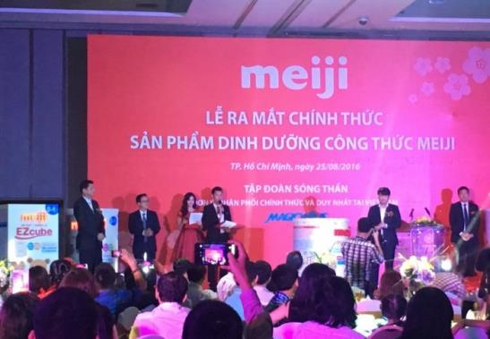
Violations found in print, online, and television advertising as well as editorial content, Facebook, YouTube and promotional events
Print Ads in Myanmar and Viet Nam
Editorial content on national TV channel in Viet Nam
Promotional event in Viet Nam
Notes:
Here are just a few examples of some of the violations that were found as part of the media scans conducted in 5 countries. The violations came from many different brands in many different formats. The reasons for violations ranged from promoting products as a replacement for breastmilk, using pictures of babies or feeding bottles, giving price discounts on formula, advertising formula for children below 12 or 24 months depending on country, and offering free samples.

Slide 6
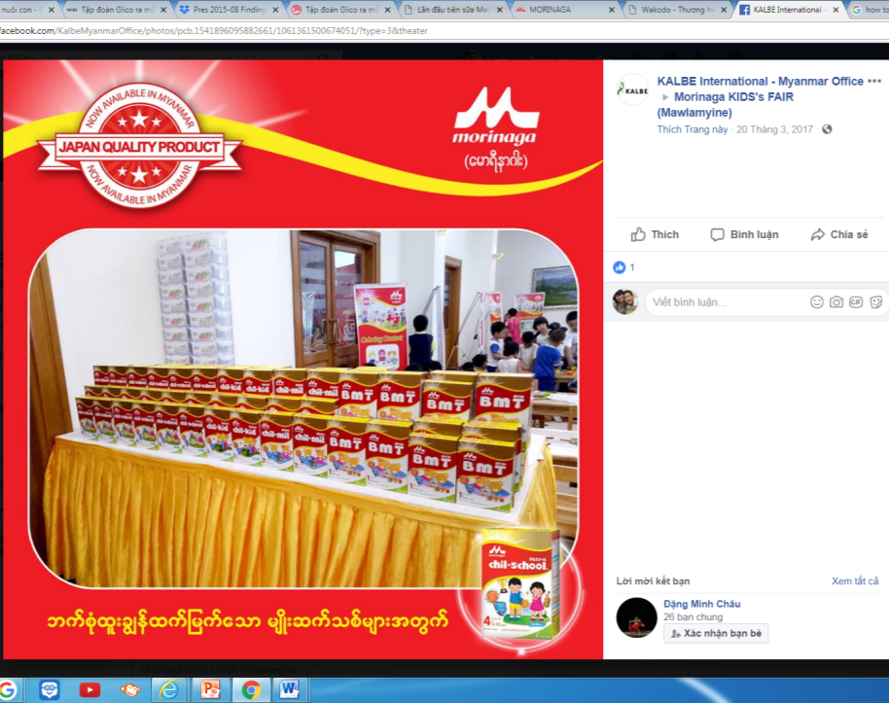
Advertisements by Japanese brands targeted inside and outside the Code
Brand: Morinaga
Event in Myanmar to promote Morinaga Step 4 (for children 3-12 years old) but also marketing other products including Step 1, 2 & 3 (for children under 2)

Slide 7
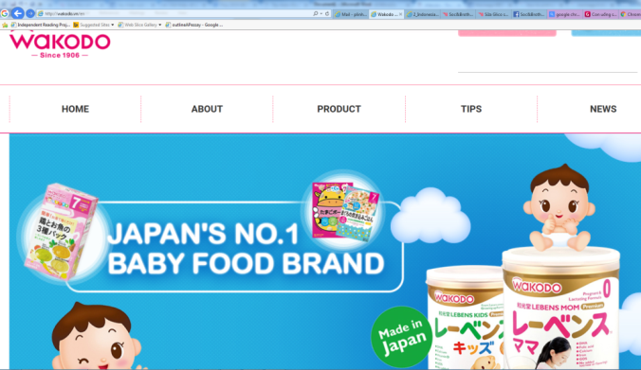
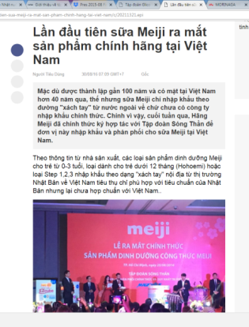
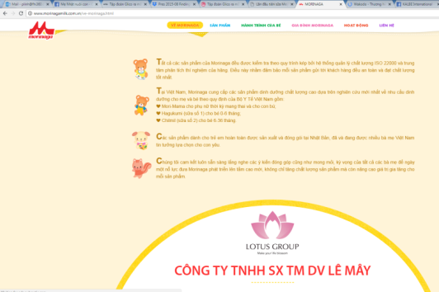
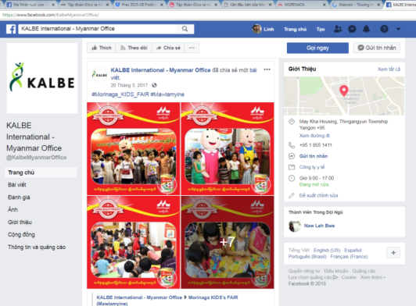
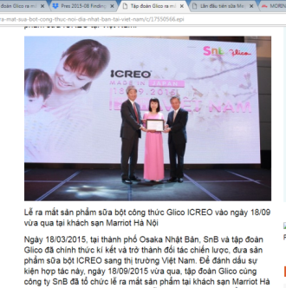
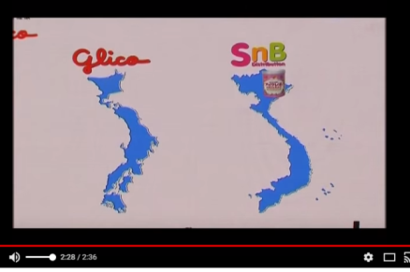
Japanese formula products mostly distributed by authorized dealers who DON’T comply the Code
Notes:
In this presentation, we only reviewed compliance and violation by the authorized dealers (wholesales and retails). Other individual distributors who are quite popular (importing products as tourist luggage) were not counted.
Websites and news of/about authorized distributors of Wakodo, Meiji, Morinaga, Glico Icreo in Viet Nam; and Morinaga in Myanmar
http://wakodo.vn
http://meijimilk.com.vn/
http://www.morinagamilk.com.vn/
http://www.icreo.com.vn/, https://www.snbshop.vn/, https://www.facebook.com/SocAndBrothers/, https://www.facebook.com/GlicoMeNhatNuoiCon/
https://www.facebook.com/KalbeMyanmarOffice/

Slide 8
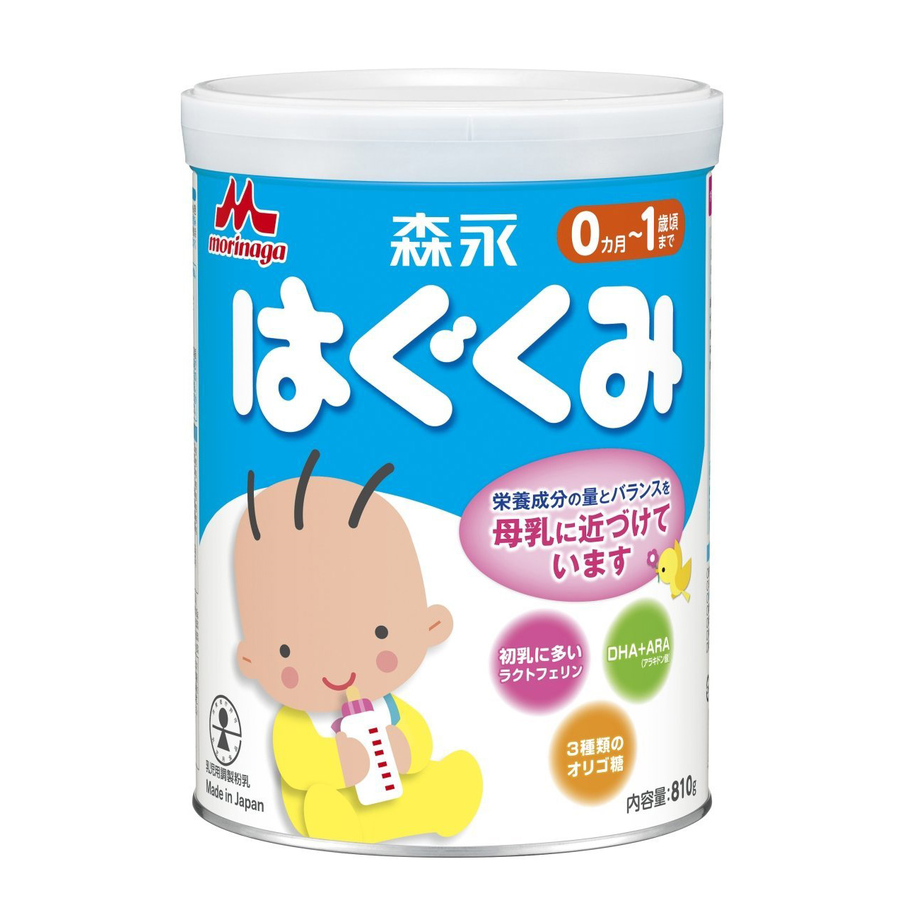
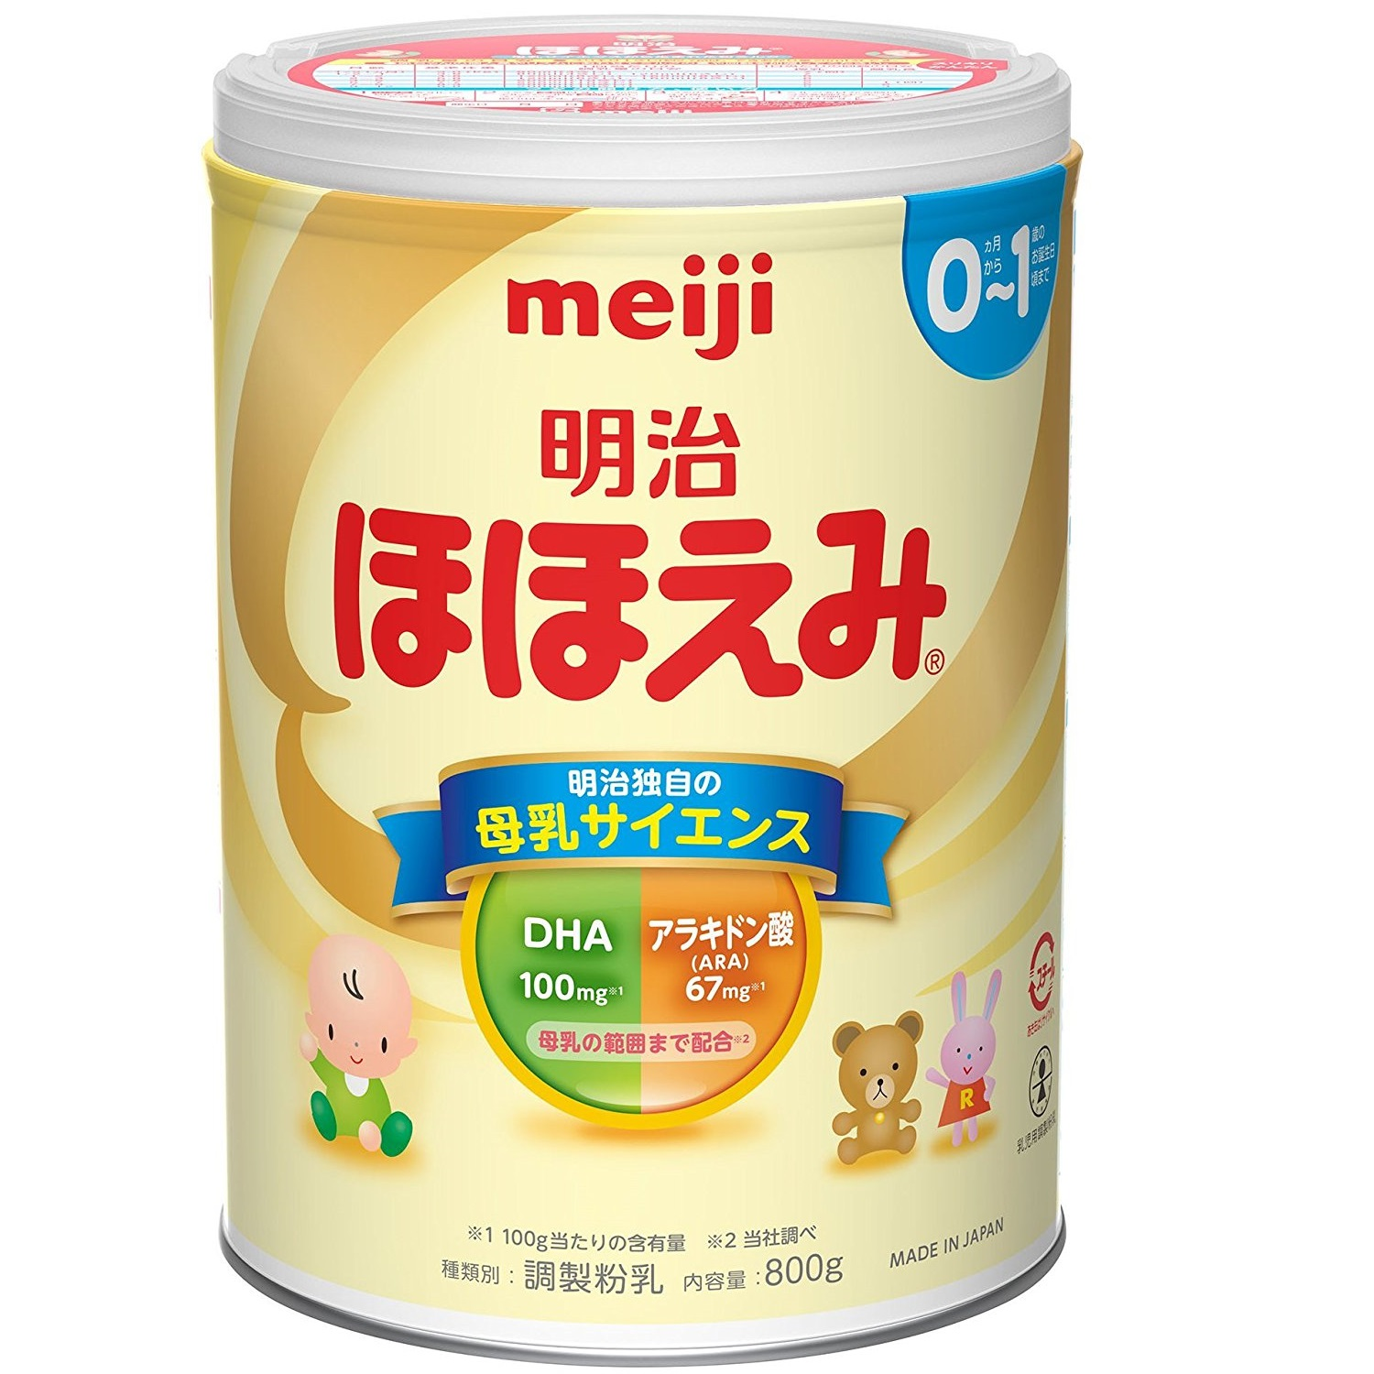
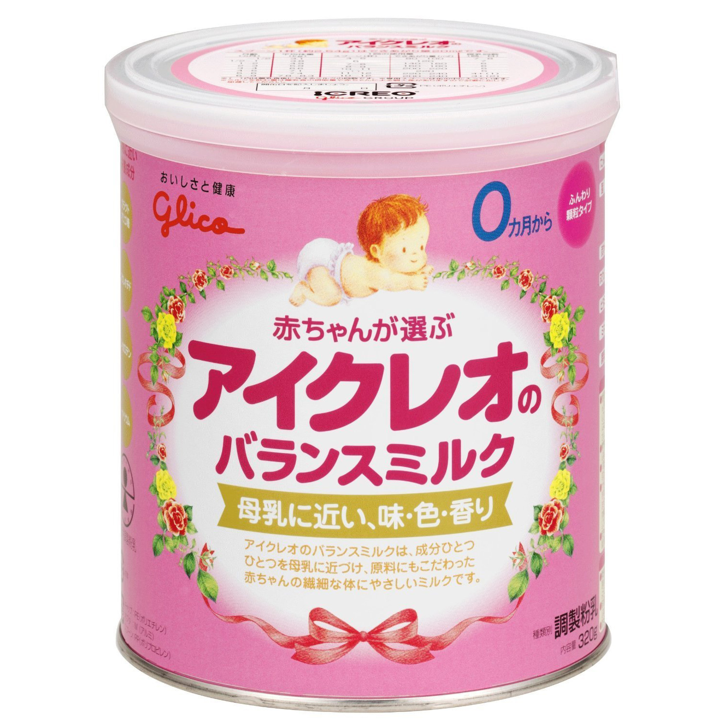
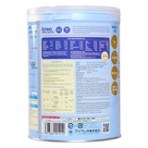


Label of formula milk for children under 24 months
Violations:
Using baby and bottle images.
Brand: Glico’s ICREO No 0 (for children 0-9 months old)
Brand: Glico’s ICREO No 1 (for children 9-36 months old)
Brand: Morinaga (for children 0-12 month old)
Brand: Meiji No 0 (for children 0-12 month old)

Slide 9
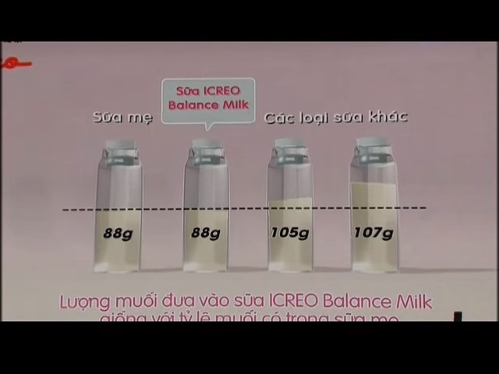
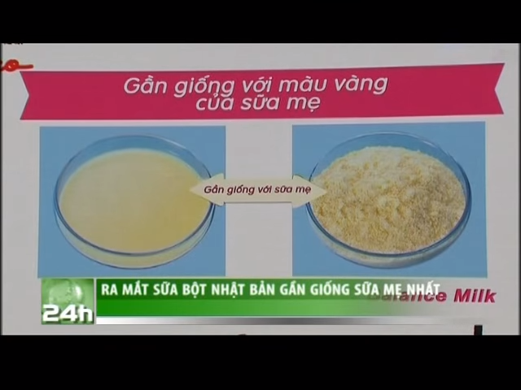
Advertising milk for children under 24 months: TVCs
Violation:
age limit (advertised for formula for children under 24m)
false nutrition and health claims/idealizing use of the product
Brand: Glico’s ICREO (for children from 0-3 years old)
Brand: Glico’s ICREO No ) for children 0-3 years old)
“Compare the quality of breastmilk with Glico’s formular of ICREO with the similar colour and same amount of salt”

Slide 10
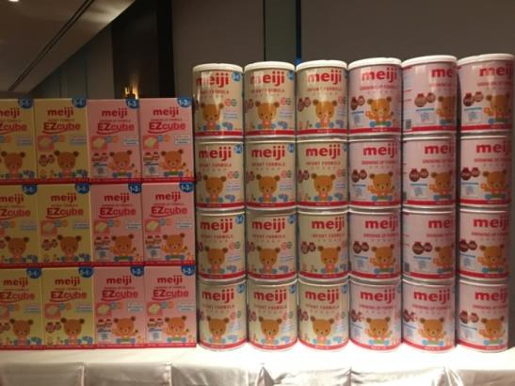
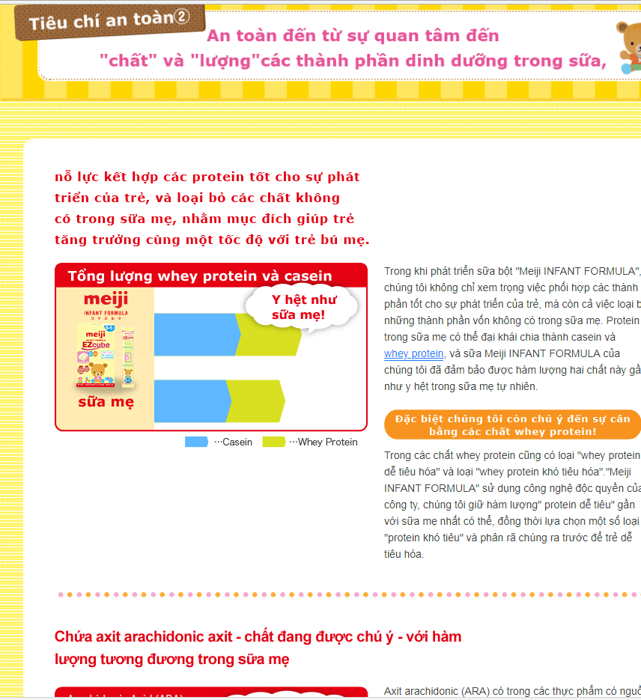
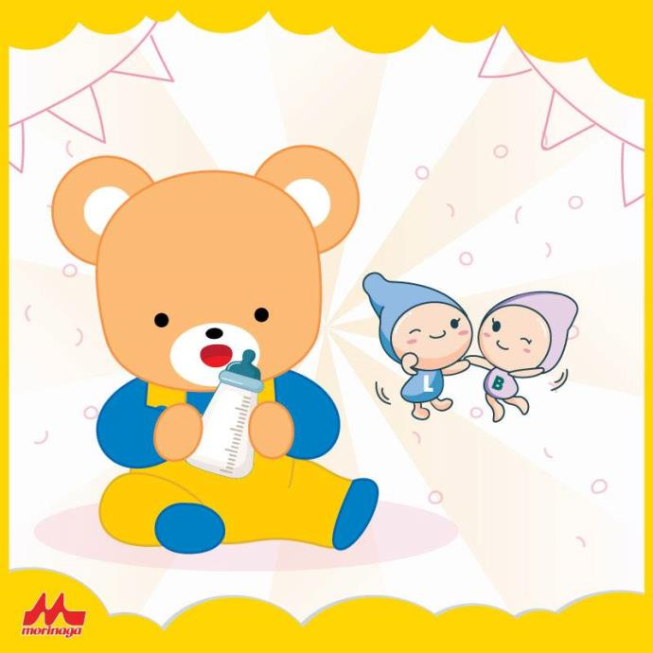
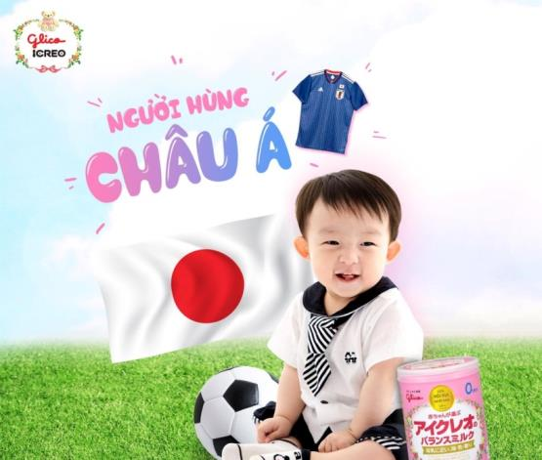
Advertising for products for children under 2
Illegal promotion, false health claims, comparing product to human milk, using bottle & baby image in ads

Slide 11
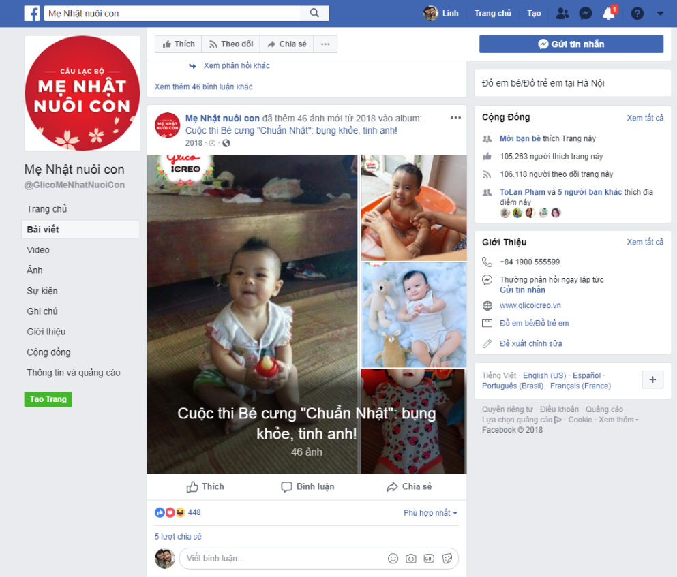
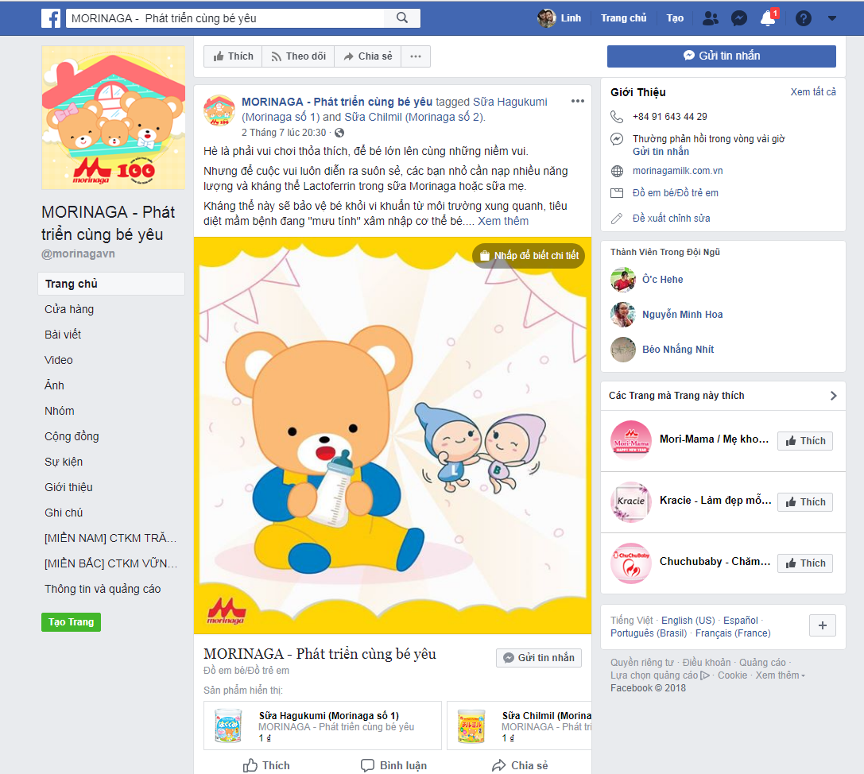
Using fanpage to promote brands and products
Notes:
BMS companies commonly used their Facebook pages to promote their brands and products and often gave advice about infant and young child feeding. BMS for children under 24 months old was promoted either directly by using ambiguously the word ‘baby’ or indirectly by showing pictures of the products, newborns, infants, or young children, or sales representatives or health workers offering free samples to new parents in hospitals. Parents were invited to like and share pictures online, and the companies gave advice about infant and young child feeding. Encouraging users to post comments, experiences or pictures provides brand sites with potential marketing content without requiring companies to break any Code rules (i.e. the proscription of the use of images idealizing artificial feeding)

Slide 12
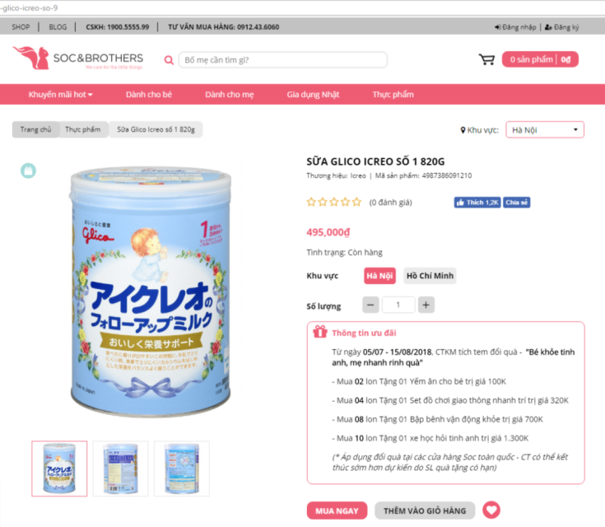
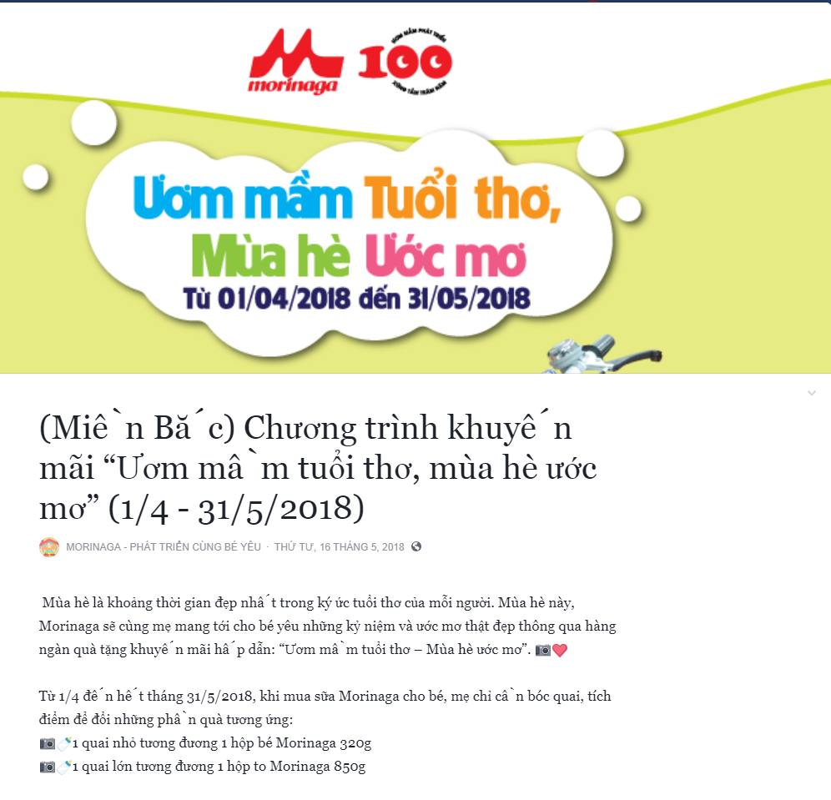
Offered gifts and discounts

Slide 13
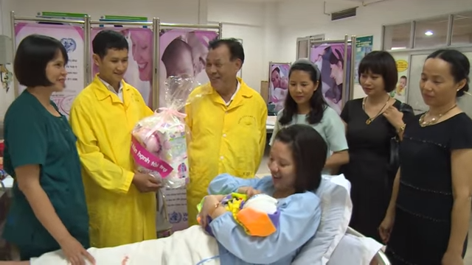
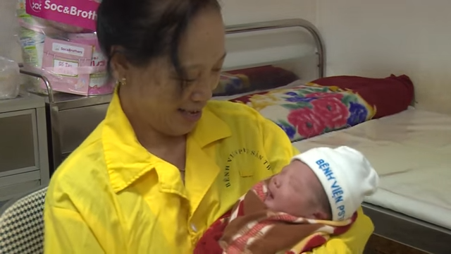
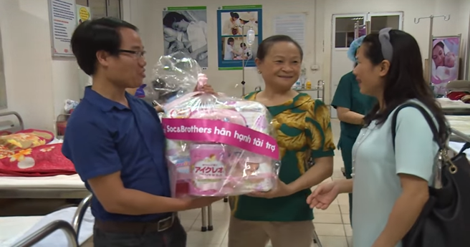
Promotion: Gifts
Brands: Glico formula milk
Violation: Illegal free promotion gift to newborn babies’ family at the hospital and direct contacts with mother/caregivers

Slide 14
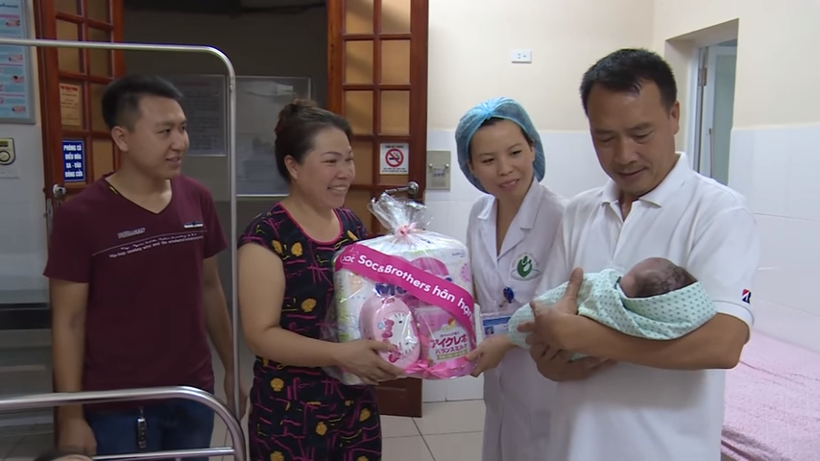

Promotion: Gifts
Brands: Glico
Violation: Illegal promotion (Free gift) for formula for children under 24m

Slide 15
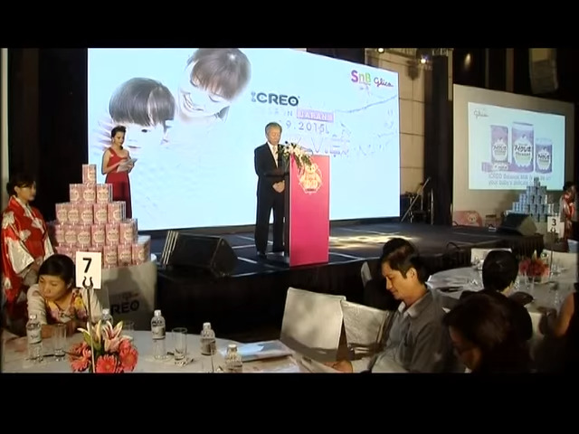
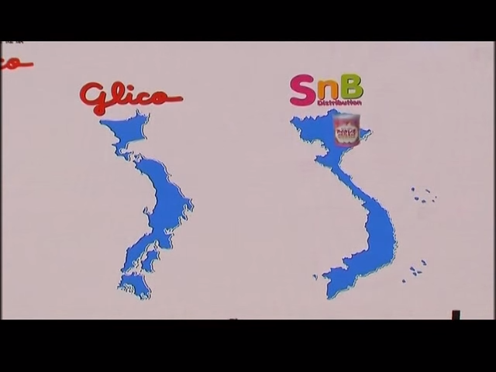
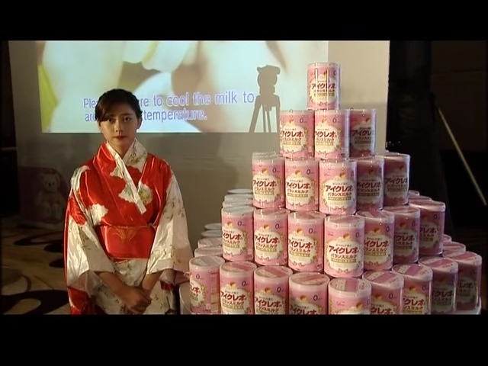
Promotion: Events
Brands: Glico’s ICREO
Violation: Events to promote formula for children under 24m
Glico’s ICREO Infant Formula event in Sep 2015
Glico Press Conference in Sep 2015

Slide 16
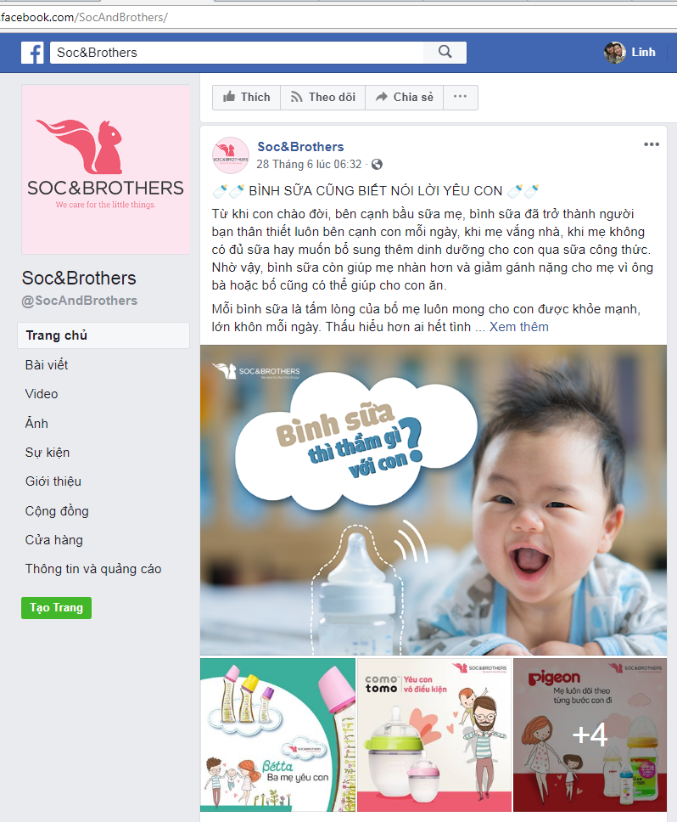
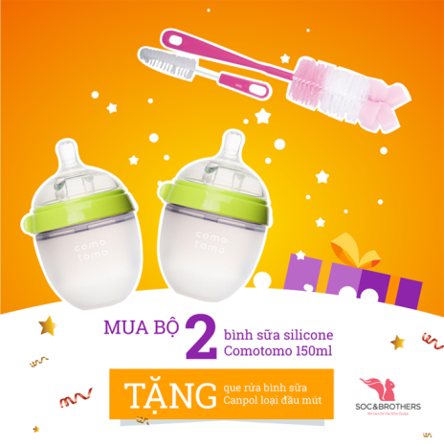

Promotion of bottle and bottle-feeding
Undermining breastfeeding, illegal promotion, offering gifts, using baby image in ads
Notes:
Fanpage of SnB Distribution who are the authorized distributor of Glico Icreo, Comotomo, Betta

Slide 17
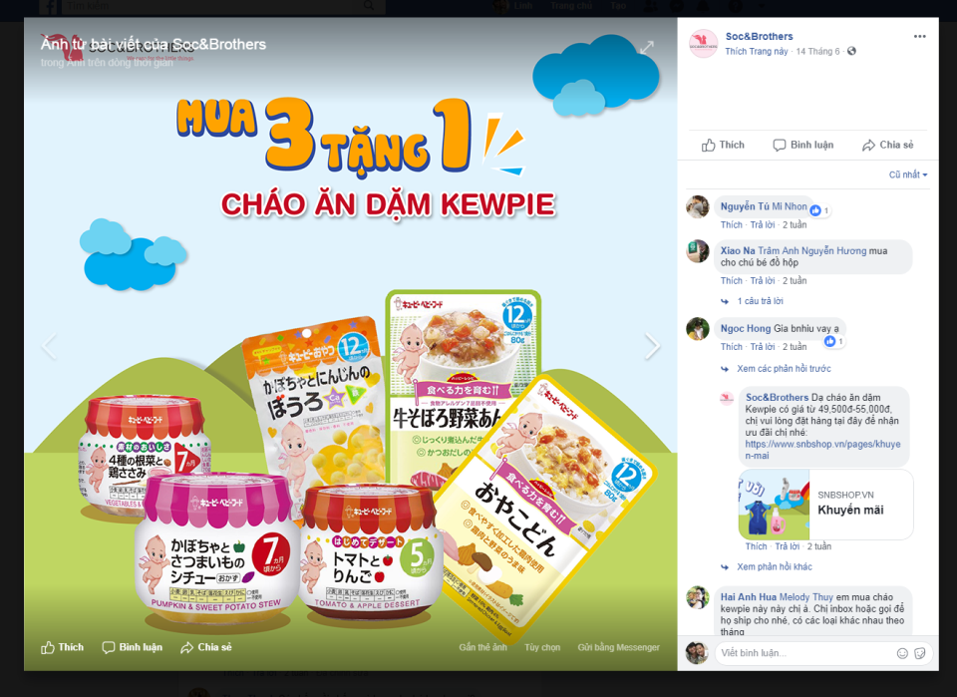
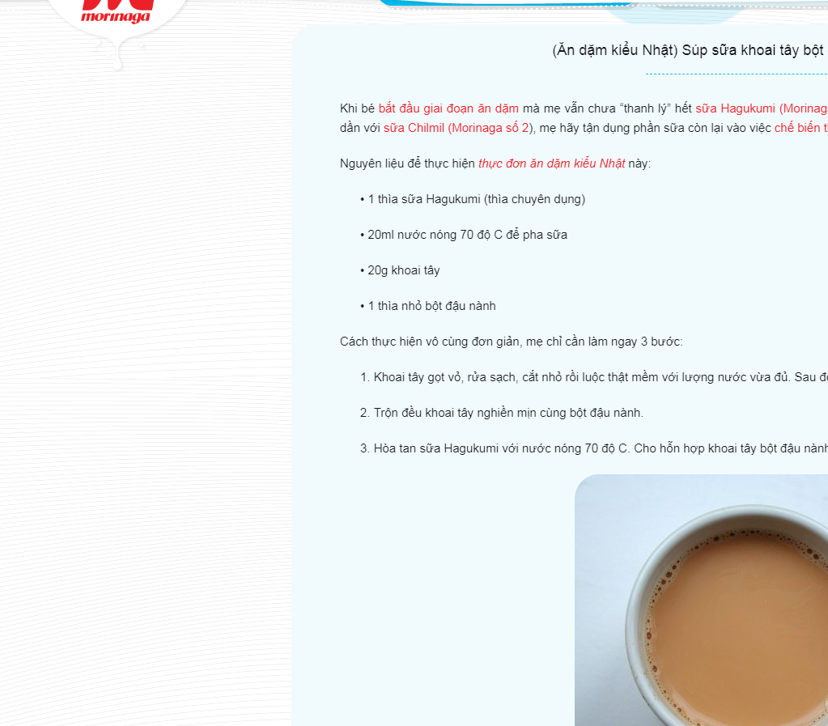
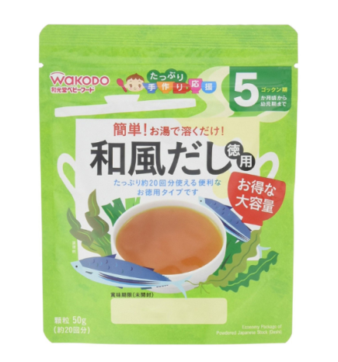
Promotion of complementary foods for children under 6 months old
Promote and advise complementary feeding for children 5 months old and illegal promotion (buy 3 get 1 more)

Slide 18
Key messages
Various violations found on media:
  Advertising for milk for children 0-24 months on TV and newspapers/magazines
  Direct contact to mothers and caregivers
  Information and events
  Idealizing formula usage
  Free samples
  Promotional gifts/prizes
Social media is utilized by companies to promote formulas
Companies and local distributors are breaking and stretching the rules
Companies have huge budgets for advertising and promotion
Local law such as Decree 100 and Advertisement Law in Viet Nam must be strengthened and enforced to eliminate these violations and cover all communication channels

Slide 19
Recommendations for protection and promotion of breastfeeding
Laws and regulations:
  Cover fully the Code and ensure strong enforcement against violations
  Cover all products that substitute breastmilk
  Bind responsibilities of producers to ensure local & abroad distributors complying to the Code
  Expand the scope of products to include those up to 36 months
  Have strong monitoring and enforcement mechanisms
Health professionals or government officials:
  Increase capacities to utilize mass media for breastfeeding protection and promotion
  Engage journalists to report on breastfeeding topics
  Ensure that media agencies are aware of the Code/regulations and clarify the roles and responsibilities
Notes:
As part of commitments made under the Convention on the Rights of the Child and the Convention on the Elimination of All Forms of Discrimination
against Women, mothers (and families) of infants and young children need to have access to consistent and unbiased information regarding infant
nutrition and breast-feeding.
Mass media is a potential channel to influence the adoption of the Code and improve breastfeeding practices. Engaging with journalists and making them awake of the consequences and controversies of unethical marketing of BMS can turn them into watchdogs and help report violations.

Slide 20




STAY CONNECTED WITH ALIVE & THRIVE
^{@aliveandthrive}
www.facebook.com/fhi360.aliveandthrive
^{www.lessguess.wordpress.com}
^{www.youtube.com/aliveandthrive}
^{www.aliveandthrive.org}
Alive & Thrive is funded by the Bill & Melinda Gates Foundation and the governments of Canada and Ireland and managed by FHI 360.

